Slide 1
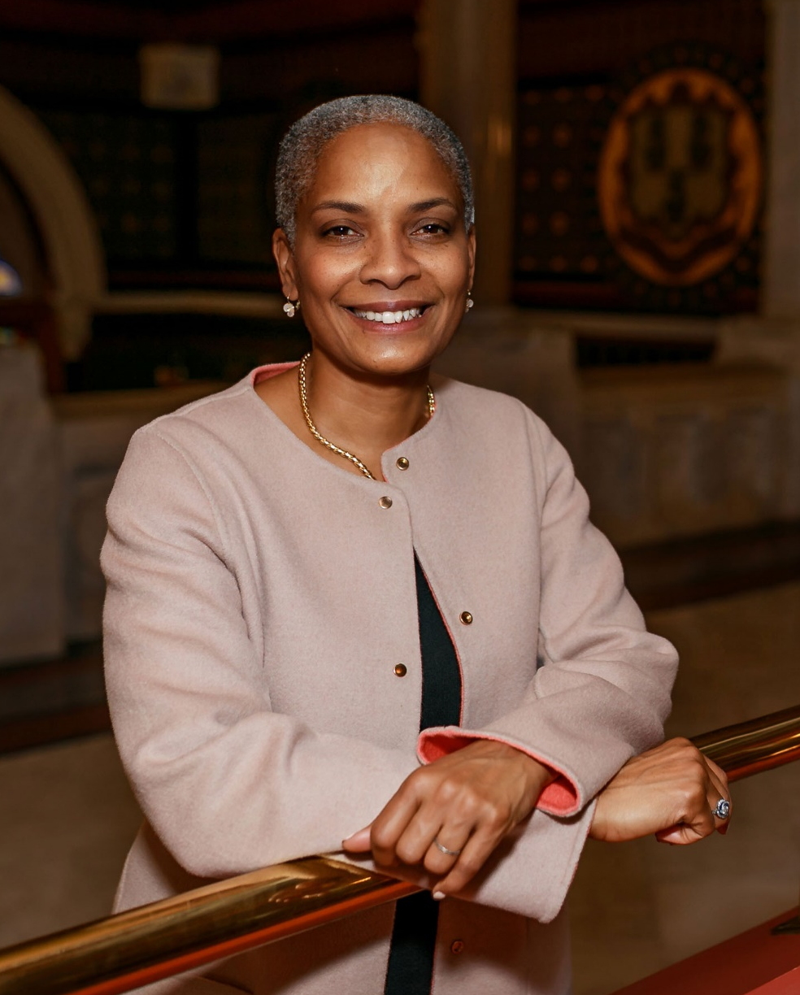
Workshop for Newly
Elected Municipal Officials
Secretary of the State Stephanie Thomas

Slide 2
OFFICE OF THE
SECRETARY OF THE STATE

Slide 3
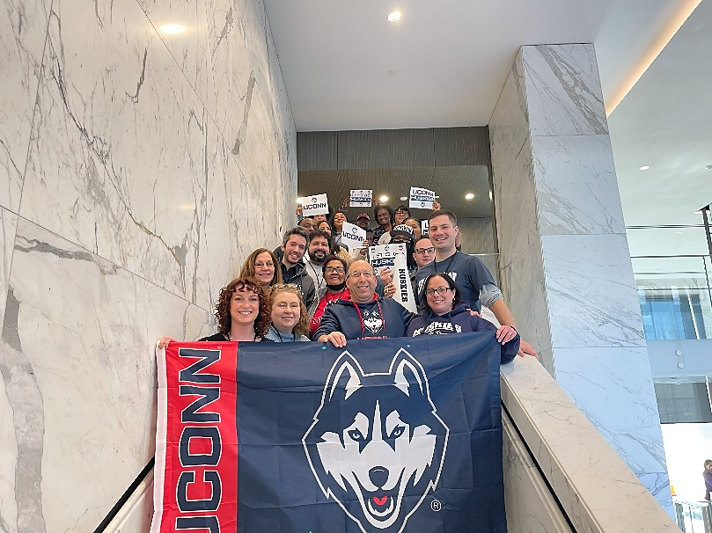
Title
Office of the Secretary of the State
11 Employees in the Election Division
vs.
45 in Business Services

Slide 4
Title
Election-Related Priorities in 2024/25
Early Voting
New role for your local election staff
Potential new connection to CVRS
Two new CVRS and EMS systems
New training for Registrars and Poll Workers
Review and approval of plans
Tabulator procurement
Cybersecurity

Slide 5
You have a Role to Play to Keep our Elections Safe!
Title
Help mitigate cybersecurity threats
Help spread correct information
Advocate for your election staff

Slide 6
SECURITY THREATS

Slide 7
Title
Most Common Security Threats
Planned or Accidental False Information
Misinformation & Disinformation
Security breech through network
Phishing, Malware, Hacking
Lack of Emergency Planning & Practice
Disruption threatens elections

Slide 8
Title
Ways You Can Help
.gov Migration
Requests can be made at get.gov/registration
Regular IT Training for Employees
Join the Multi-State Information Sharing and Analysis Center (MS-ISAC) and the Election Infrastructure Information Sharing and Analysis Center (EI-ISAC)

Slide 9
CIVIC EDUCATION

Slide 10
Title
Educate Members of Your Town
Take the CEO Pledge
Nonpartisan lawn signs
Usage of electronic boards
Share SOTS social media posts
Red, White, & Blue Schools Program
K-12 eligible to participate
Poll worker recruitment
Age 16+

Slide 11
EARLY VOTING

Slide 12
Title
What is Early Voting?
Early Voting allows you to vote in-person before Election Day
Safe and secure
Ballots are not opened until Election Day
46 other states already offer some form of Early Voting

Slide 13
Title
Early Voting vs. Absentee Voting
No excuse is needed for early voting, while an excuse is still required to vote by absentee ballot.
Early voting is only done in-person, while absentee ballots may be returned in-person, via mail, or to a drop box.

Slide 14
Title
When will Early Voting Begin?
The 2024 Presidential Preference Primary will be held in Connecticut on April 2.
The Early Voting Days for that election are:
Tuesday, March 26
Wednesday, March 27
Thursday, March 28
Saturday, March 30
Note: Good Friday and Easter exempted

Slide 15
Title
Number of Early Voting Days
4 Days – Presidential Preference Primaries
4 Days – Special Elections
7 Days – Other Primary Elections
14 Days – General Elections
The period ends the Sunday before Election Day
NO Early Voting for Town Referenda or Town Committee elections

Slide 16
Title
Times of Day
All Days of the PPP and Special Elections
10AM to 6PM
All Days of Primary and General Elections
10AM to 6PM, EXCEPT
8AM to 8PM on the Tuesday & Thursday prior to Election Day
Election Day Hasn't Changed
6AM to 8PM at normal polling location

Slide 17
Title
Locations
Every municipality SHALL have ONE location
Municipalities 20,000+ MAY have additional locations
Location must have secure CVRS line
Location must be the same throughout the entirety of the early voting period
Whether or not to have a second location is determined by local legislative body of the municipality – there are two methods by which they may reach that decision

Slide 18
Title
Method of Voting
In-Person
Eligibility look up
Provided with ballot and envelope
Vote and seal ballot in signed envelope
Custody and control is similar to absentee ballots
Stored and opened on Election Day
Results segregated – in person, early, absentee

Slide 19
Title
Reminder
In 2026, the United States will
Commemorate the 250th anniversary of the Declaration of Independence
The CT250 Committee wants your help!
Visit CT250.org to learn more

Slide 20
QUESTIONS?

Slide 21
THANK YOU!

