Slide 1
Ethics, Accountability, and Conflicts of Interest
Kari L. Olson
860-240-6085 | kolson@murthalaw.com
COST's Workshop for Newly Elected & Returning Municipal Officials
January 9, 2024

Slide 2
Speaker:
KARI L. OLSON
Ms. Olson is a partner in the firm's Litigation Department and chair of the firm’s Municipal and Land Use practice groups. She received her B.S., Cum Laude, from the University of Connecticut and, in 1998, her J.D. with High Honors from the University of Connecticut School of Law. She was admitted to the Connecticut Bar in 1998. Ms. Olson concentrates her practice in general municipal law and land use litigation. She represents municipalities in all matters of municipal concern and governance. Listed in The Best Lawyers in America® in the area of Land Use and Zoning (Copyright 2019 by Woodward/White, Inc., Aiken, SC)
Notes:
2

Slide 3
Disclaimer
This presentation contains educational material that provides only a general overview. This presentation and materials do not constitute legal advice. Please contact us if you would like specific legal advice.
Notes:
3

Slide 4
Introduction
Concerns regarding ethics have become a serious issue in recent years.
Governors
Mayors
Finance Directors
Volunteer Commission Members
Our objective today is to provide you with a general overview of ethics – from both a legal and practical perspective – and to provide you with some advice for dealing with difficult issues in the future.
Notes:
4

Slide 5
WHAT IS ETHICS?
A moral code that governs a person’s or group’s behavior
Synonyms: moral code, morals, morality, values, rights and wrongs, principles, ideals, standards (of behavior), value system, virtues, dictates of conscience
The concept is very broad
Focus today is on “professional” ethics; how you conduct yourself within the realm of your public service
Notes:
5

Slide 6
WHY DO WE CARE?
Like it or not, you are engaged in public service, whether elected or appointed, paid or volunteer
You are subject to enhanced scrutiny of your moral character
You are required to comply with State and local laws regarding ethics
The failure to act properly could have legal, employment, financial and/or embarrassing consequences
Notes:
6

Slide 7
Purpose of Ethics Rules
Ensure governmental decisions and policies are made through the proper channels.
Prevent public office from being used for personal gain.
Promote public confidence in the integrity of its government.
Notes:
7

Slide 8
Purpose of Ethics Rules
By and large, the purpose of ethics rules in the professional context are achieved by avoiding
CONFLICTS OF INTEREST
Notes:
8

Slide 9
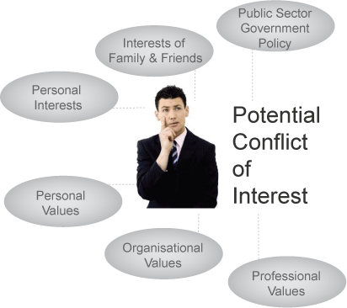
CONFLICTS OF INTEREST
Generally speaking, ethics rules are designed to avoid actions when the action presents a conflict of interest for the actor
What is a conflict of interest?
A term used to describe the situation in which a public official or fiduciary who, contrary to the obligation and absolute duty to act for the benefit of the public or a designated individual, exploits the relationship for personal benefit, typically but not always pecuniary.
Notes:
9

Slide 10
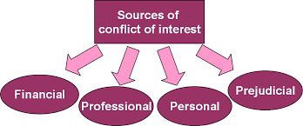
TYPICAL SOURCES OF CONFLICTS OF INTEREST
The usual suspects
Notes:
10

Slide 11
Conflicts of Interest -Generally
Conflict of interest : Acting in one’s official capacity, when one has
a personal interest, such as a matter involving a close relative or business associate or your career; or
a financial interest; or
a personal bias or predilection that prevents you from being objective.
Notes:
11

Slide 12
CONFLICTS OF INTEREST
Can be Perceived or Actual
Not all personal interests represent a conflict of interest
Can be difficult to identify
Can be even harder to define by rule
Notes:
12

Slide 13
Perceived Conflicts of Interest
Situations that present a conflict but for which there is no real improper influence.
Example: You are in charge of hiring and your mother-in-law applies for a job
She is the most qualified candidate
You hire her based upon merit
In fact, you HATE your mother-in-law
Notes:
13

Slide 14
HOW TO DEAL WITH PERCEIVED CONFLICTS: APPEARANCE OF IMPROPRIETY
Standard applied to judges and others by statute and common law
Means that there need be no rule that specifically prohibits your conduct but, nonetheless, you must consider what a reasonable member of the general public would think.
“The appearance of impropriety is a phrase referring to a situation which to a layperson without knowledge of the specific circumstances might seem to raise ethics questions. For instance, although a person might regularly and reliably collect money for her employer in her personal wallet and later give it to her employer, her putting it in her personal wallet may appear improper and give rise to suspicion, etc. It is common business practice to avoid even the appearance of impropriety.”
Bottom Line: It is something to AVOID!
Notes:
14

Slide 15
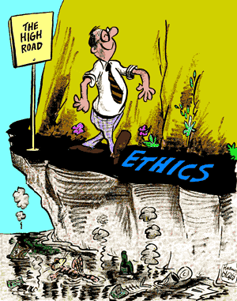
APPEARANCE OF IMPROPRIETY
Have to consider what is best for the Town. Sometimes you have to swallow hard and take the “high road.”
Notes:
15

Slide 16
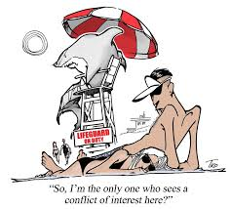
ACTUAL CONFLICTS OF INTEREST
Conflicts expressly forbidden by rule or policy
Conflicts not expressly forbidden but for which you are improperly influenced in your decision
Requires introspection
Notes:
16

Slide 17
ACTUAL CONFLICTS OF INTEREST: LAWS GOVERNING ETHICS
State Code of Ethics (Conn. Gen. Stat. § 1-79, et seq.)
Statutory Agency Code of Ethics (e.g., Conn. Gen. Stat. Sections 7-148t, 8-11 and 8-21).
Municipal Code of Ethics
Case law
International City/County Management Association (ICMA): https://icma.org/sites/default/files/ICMA%20Code%20of%20Ethics%20%28Amended%20June%202017%29_0.pdf
Notes:
17

Slide 18
Does Your Town Have A Code of Ethics?
Town Policy: Many towns prescribe ethical standards of conduct for public officials and employees.
Town Charter
Code of Ordinances
Notes:
18

Slide 19
New Britain Ethics Code: Article VI; Chapter 2
Sec. 2-446. - Title and purpose.
This section shall be known and referred to as the "Code of Ethics of the City of New Britain."
The purpose of this Code of Ethics is to establish and maintain high standards of honesty, integrity, and impartiality for the mayor and for all elected and appointed officials in the City of New Britain.
Sec. 2-448. - Purpose of the Code of Ethics.
(a) Every official and employee shall avoid the participation in a private interest or relationship, which conflicts with his/her public duty and shall avoid any conduct or actions in any matter in which his/her participation would tend to undermine public confidence.
(b) Only an action by an official or employee in violation of the provisions set forth in section 2-449 shall constitute a violation of the Code of Ethics
Notes:
19

Slide 20
Does Your Town Have An Ethics Board?
Any town, city, district, or borough may, by charter provision or ordinance, establish a board, commission, council, committee or other agency to investigate allegations of unethical conduct, corrupting influence or illegal activities levied against any official, officer or employee of such town, city, district or borough. See Conn. Gen. Stat. § 7-148h.
Are there restrictions on who can be members?
Notes:
20

Slide 21
New Britain Ethics Board
Sec. 2-461. - Members; appointment; qualifications; vacancies; political activity.
(a) There shall be a board of ethics consisting of five (5) members. All members shall be appointed by the mayor in accordance with subsections 5-2(e) and 7-1(b) of the City Charter. The members shall be appointed for a term of three (3) years, provided that members may continue in office until a successor has been appointed. Appointments shall be subject to 9—167a of the Connecticut General Statutes.
(b) All members shall be residents of the city. No member shall:
(1) Hold or campaign for any public office;
(2) Have held public office or have been a candidate for public office for a one-year period prior to appointment;
(3) Hold office in any political party or political committee;
(4) Serve as a member of any other municipal agency;
(5) Be a public official or public employee of the municipality or an official or employee of a quasi-public agency of the municipality; or;
(6) Any immediate family member of any official or employee.
(c) (1) Although any member of the board shall have an unrestricted right to vote, make political contributions, attend fundraising or other political events, no member or employee shall publicly support any candidate for any municipal office subject to the board's jurisdiction. An individual would be publicly supporting a candidate by, for example, volunteering as a campaign worker, giving a speech at a political event or formally endorsing a candidate;
(2) No candidate for political office may disseminate information which indicates that a board member supports his or her candidacy.
Notes:
21

Slide 22
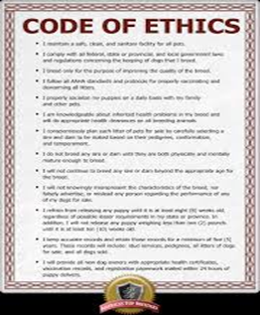
WHAT EVERY GOOD MUNICIPAL ETHICS CODE SHOULD HAVE
General Application
Clear and concise standards regarding conflicts of interest
Avenue for assistance
Policy or process for implementing
Opportunity for redress
Notes:
22

Slide 23
GENERAL APPLICATION – TO WHOM DOES THE CODE APPLY?
Elected Officials
Appointed Officials
Boards
Commissions
Committees
Employees
Independent Contractors
Notes:
23

Slide 24
New Britain Code Definitions; Section 2-447
Official or employee means any official, employee, agent, consultant or member, elected or appointed to, or retained by any city agency, whether paid or unpaid, whether permanent, temporary or provisional.
City agency means and includes the common council, the board of education and all other agencies, boards, committees, commissions, departments and offices of the city.
Notes:
24

Slide 25
Clear and Concise Standards
What is a Conflict?
How Do You Define?
Personal
Financial
Other
Likely Will Be Over or Under Inclusive.
Notes:
25

Slide 26
NEW BRITAIN CONFLICTS OF INTEREST Sec. 2-450. - Interest in conflict with discharge of duties.
An official or employee has an interest which is in substantial conflict with the proper discharge of his duties and of his responsibilities as prescribed in the charter and ordinances of the city and the laws of the state if he has reason to believe or expect that he, any member of his immediate family or business with which he is associated will derive a direct monetary gain or suffer a direct monetary loss, as the case may be, by reason of his official activity. He does not have an interest which is in substantial conflict with the proper discharge of his duties and of his responsibilities, if any benefit or detriment accrues to him, any member of his immediate family or business with which he is associated as a member of a business, profession, occupation or group to no greater extent than any other member of such business, profession, occupation or group.
Notes:
26

Slide 27
NEW BRITAIN STANDARDS OF CONDUCT
Sec. 2-449. - Prohibited activities.
(a) No official or employee shall have any interest, financial or nonfinancial, direct or indirect, or engage in any business, employment, transaction or professional activity, or incur any obligation of any nature, which is in substantial conflict with the proper discharge of his/her duties and responsibilities as prescribed in the charter and ordinances of the city or the laws of the state.
(b) No official or employee shall accept other employment that will affect his/her independence of judgment or cause him/her to disclose confidential information acquired in the course of and by reason of official duties.
(c) No official or employee shall willfully and knowingly disclose confidential information acquired in the course of and by reason of official duties. He/she shall not use any confidential information obtained from public office or employment to obtain financial gain for himself/herself, family member or a business with which he/she is associated.
Notes:
27

Slide 28
NEW BRITAIN STANDARDS OF CONDUCT
Sec. 2-449. - Prohibited activities.
(d) No official or employee shall agree to represent, appear for or take action on behalf of another person before any city agency for a fee or other consideration. This includes being a member or employee of a partnership, association or professional corporation that could represent another person.
(e) No person shall offer or give to an official or employee or his spouse, his parent, brother, sister or child or spouse of such child or a business with which he is associated, anything of value, including, but not limited to, a gift, loan, political contribution, reward or promise of future employment based on any understanding that the vote, official action or judgment of the official or employee would be or had been influenced thereby.
(f) No official or employee shall solicit or accept, and no person shall offer or give an official or employee or his/her relative, anything of value, including but not limited to, a gift, loan, political contribution, reward or promise of future employment based on any understanding that the vote, official action or judgment of the official or employee would be or had been influenced thereby.
Notes:
28

Slide 29
NEW BRITAIN STANDARDS OF CONDUCT
Sec. 2-449. - Prohibited activities.
(g) No official or employee or member of his immediate family or a business with which he/she is associated shall enter into any contract with any city agency unless the contract has been awarded through an open and public process. This process must include any prior public offer and subsequent public disclosure of all proposals considered and the contract awarded. Any contract made in violation of this paragraph of this paragraph shall be voidable by a court of competent jurisdiction provided the suit is begun within ninety (90) days of the making of the contract.
(h) No official or employee shall grant or make available to any person any consideration, treatment, advantage or favor that it is not available to the general public.
(i) No official or employee shall request, use or permit the use of any publicly-owned or publicly-supported property, vehicle, equipment, labor or service for the personal use unless it is also made available to the general public. This rule shall not be deemed to prohibit uses that are provided as a matter of stated public policy and are for the use of officials and employees in the conduct of official business.
Notes:
29

Slide 30
NEW BRITAIN STANDARDS OF CONDUCT
Sec. 2-449. - Prohibited activities.
(j) No official or employee shall disclose any information concerning matters discussed in a duly convened executive session of a public agency.
(k) No official or employee who makes decisions on behalf of the public shall participate in matters in which he or his immediate family will gain financial advantage or suffer financial detriment as a result of the decision reached. In any situation in which a decision on any question can not be arrived at without the participation of a decision-maker who would otherwise be disqualified under this paragraph, such decision-maker may participate and act, but shall make his conflict of interest public.
(l) No official may appoint or hire any member of his/her immediate family to any paid position with the city.
Notes:
30

Slide 31
Personal Conflict of Interest - Example
You are the new First Selectman
You are charged with appointing various commission and board members for the Town
A particular resident is seeking appointment to the ethics board
He is well qualified for the job as he sits on the State Ethics Board
He did not vote for you in the last election and is in a different registered political party
You know he is the right person for the job and would benefit the Board but you don’t like him and want to stick it to him because he did not vote for you.
Notes:
31

Slide 32
Conflicts of Interest - Close Relative or Business Associate
A relationship that would tend to
influence improperly that individual's judgment, in his official capacity, on a particular issue or item.
New Britain: Immediate family means any spouse, dependent children, parent (birth or adoptive), or dependent relatives who reside in the individual's household.
West Hartford – Blood or marriage relationship
Some towns are even more specific – e.g. Norwalk: IMMEDIATE FAMILY: Includes, but is not limited to, a spouse, child, grandchild, brother, sister, in-law, parent or grandparent, stepparents and stepchildren, or persons who reside in the same household.
Bottom Line: Would you tend to favor or disfavor the individual based upon your familial or personal relationship?
Notes:
32

Slide 33
Conflicts of Interest - Close Relative or Business Associate - Example
The town is seeking to hire an assistant tax collector.
Although, there will be three people from the town interviewing candidates, the Mayor will make the ultimate decision.
The Mayor is in the excavation business.
John works for a company that Mayor relies upon to supply most of the gravel needed for Mayor’s company projects.
John also threw a political fundraiser for the Mayor last year.
John mentions to the Mayor that his son is applying for the job and that “he’s an ideal candidate.”
Any issue with the mayor hiring John’s son?
What if John’s son is most qualified and the best candidate?
What if John is the mayor’s brother? Nepotism?
Notes:
33

Slide 34
Conflicts of Interest - Close Relative or Business Associate – Example
You are a member of the Board of Assessment Appeals.
You are also a dentist and most of your patients reside in town.
You are slated to hear a current patient’s appeal of his/her real estate taxes
Notes:
34

Slide 35
Conflicts of Interest - Financial Conflicts
May not have a financial interest in Town matters. In most towns with an ethics code it, it applies to any:
Contract with the Town,
Sales to the Town,
Purchases from the Town, or
Compensable services involving the Town.
Notes:
35

Slide 36
Financial Disclosure Requirement: New Britain
Sec. 2-453. - Disclosure of financial interests; filing requirements.
(a) The mayor, members of the common council, city clerk, collector of taxes, treasurer, members of the board of assessment appeals, constables and registrars of voters, each department head including the purchasing agent and each attorney in the office of corporation counsel, subject to the applicability of any collective bargaining agreement, shall file, under penalty of false statement, a statement with the town and city clerk within thirty (30) days of taking office or the date of appointment and on an annual basis thereafter which provides the following information.
(1) Real estate located in the City of New Britain, excluding the place of principal residence, which is owned or leased for a period exceeding two (2) years by such official, employee or spouse, including any corporation, trust or partnership where either the official or spouse have at least five (5) per cent of a legal or equitable interest;
(2) The name of any employer from which the official, employee or spouse is paid an annual income of at least ten thousand dollars ($10,000.00) and the name of any business entity owned by the official, employee or spouse, including any corporation, trust or partnership, where either the official, employee or spouse have at least five (5) per cent of a legal or equitable interest;
(3) The name of any business entity identified under subsection (2) of this section which had a contract with the City of New Britain the preceding calendar year to provide either goods or services in the aggregate amount of at least ten thousand dollars ($10,000.00); and
(4) A certification that each official or employee has read and understands the City of New Britain Code of Ethics.
Notes:
36

Slide 37
Conflicts of Interest - Financial Conflicts
Includes outside employer or close family member.
Includes interest as a principal, surety, officer, or partner in a company.
Exception for competitively-bid contracts.
Notes:
37

Slide 38
Conflicts of Interest – Financial Conflicts - Example
You work for the Department of Public Works.
You also operate a snow plow business.
You’ve negotiated a contract with the Town for your company to plow all of the municipal parking lots.
Any problem?
What if you offered the best price?
What if the contract was with your spouse’s company?
What if the contract was with your friend’s company?
Notes:
38

Slide 39
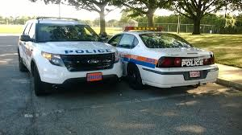
Use of Town Property
May not use or permit the use of:
Town funds,
Town services, or
Town property, equipment or materials
Except for proper purposes of the Town.
Notes:
39

Slide 40
Use of Town Property – Example
You are the town building inspector.
In order to perform you daily activities, you are given a municipal car.
Rather than drive back to the town hall after making afternoon inspections, you occasionally use the municipal car to commute to/from work.
Notes:
40

Slide 41
How do I know if I have a conflict of interest?
What does your local code or general statute say?
Where there is no express rule, ask yourself, “Can I make a fair determination and not be influenced by the suspect relationship?”
Remember: Appearance of Impropriety.
Follow your avenues for assistance and/or ask the Town Manager, Mayor or the Town Attorney for assistance.
Notes:
41

Slide 42
Disclosure Requirements
Immediately disclose the nature and extent of that interest.
Does the disclosure need to be in writing? Written disclosures should be addressed to the Town Clerk, Town Manager or Mayor.
Notes:
42

Slide 43
New Britain Disclosure Requirements
Sec. 2-452. - Procedure when discharge of duty affects member's financial interest or may constitute impropriety or appearance of impropriety.
Any official or employee who, in the discharge of his official duties or responsibilities, would be required to take an action that would directly or indirectly affect a financial interest of himself, any member of his immediate family or business with which he is associated, other than an interest of a de minimis nature or an interest that is not distinct from that of a substantial segment of the general public, shall be excused from voting or deliberating or taking action on the matter if he so requests, but if he does not make such request he shall take the following action:
(1) Prepare a written statement signed under penalty of false statement describing the matter requiring action and the nature of the potential conflict; state why despite the potential conflict, he is able to vote and otherwise participate fairly, objectively and in the public interest; and
(2) Deliver a copy of the statement to the board of ethics and if he is a member of the common council or the board of education, he shall deliver a copy of the statement to be recorded in the minutes of the body; or
(3) If he is not a member of the common council or the board of education, he shall prepare a written statement signed under penalty of false statement describing the matter requiring action and the nature of the potential conflict and deliver a copy of the statement to his immediate superior, if any, who shall assign the matter to another employee or if he has no immediate superior, he shall take such steps as the commission shall prescribe or advise to remove himself from influence over actions and decisions on the matter; or
(4) If the individual in question is the mayor of the city, he shall recuse himself from deliberating or taking action on the matter immediately.
Notes:
43

Slide 44
Significant Financial Conflicts
Written disclosure should definitely be considered if you have a significant financial interest, direct or indirect, in any contract, transaction or decision of any agency, agent, officer, board or commission of the Town.
Notes:
44

Slide 45
If you have a conflict of interest – what should you do?
May not act in any official town capacity to influence or affect the matter.
Must “recuse” (disqualify) yourself from participating in the matter:
Voting or making a determination.
Discussing the matter on or off the record.
Notes:
45

Slide 46
Following Disclosure of a Conflict
May not in any way condone, promote, encourage, influence or otherwise attempt to affect action.
May not act in any way that will or may conflict with your Town duties.
Notes:
46

Slide 47
Confidential Information
Can’t disclose confidential information concerning the Town’s property, government business or affairs to others.
Can’t use confidential information for private benefit of self or others.
Notes:
47

Slide 48
Example - Confidential Information
Knowing that the Town may buy or develop a piece of land, acquire adjoining property which is likely to increase in value.
Advise a friend or family member about plans to develop or acquire a piece of land, so they may benefit similarly.
Notes:
48

Slide 49
Prohibited Use of Influence
New Britain: 2-449(c)
No official or employee shall willfully and knowingly disclose confidential information acquired in the course of and by reason of official duties. He/she shall not use any confidential information obtained from public office or employment to obtain financial gain for himself/herself, family member or a business with which he/she is associated.
Notes:
49

Slide 50
Gifts, gratuities and favors
May not accept or solicit for personal gain any:
improper favor,
service, or
item of value
If doing so may tend to influence improperly your performance of Town duties.
Notes:
50

Slide 51
New Britain – Improper Gifts Prohibited § 2-449
(g) No person shall offer or give to an official or employee or his spouse, his parent, brother, sister or child or spouse of such child or a business with which he is associated, anything of value, including, but not limited to, a gift, loan, political contribution, reward or promise of future employment based on any understanding that the vote, official action or judgment of the official or employee would be or had been influenced thereby.
(f) No official or employee shall solicit or accept, and no person shall offer or give an official or employee or his/her relative, anything of value, including but not limited to, a gift, loan, political contribution, reward or promise of future employment based on any understanding that the vote, official action or judgment of the official or employee would be or had been influenced thereby.
Notes:
51

Slide 52
How do other Municipalities define the term - “Gift”?
In Norwalk: An officer or employee in the course of his or her work for the City shall not personally solicit or accept any gift, form of service, compensation or any item of property of a value exceeding $50.
Other Towns may define an improper gift more by what it DOES NOT include.
(1) Gifts or social courtesies related to a family relationship or established personal friendship between an officer or employee and the donor, which are not designed to influence the judgment or action of the officer or employee within the scope of his or her official responsibility and/or authority.
(2) Attendance at events of a charitable, public, governmental, informational or business nature where refreshments may be served and small souvenirs of the event, of a minor monetary value, (not exceeding $50 in value) may be distributed or made available to all attendees, and which are not designed to influence the proper judgment or action of the officer or employee within the scope of his or her official responsibility and/or authority.
(3) Political contributions received in compliance with applicable laws and regulations.
(4) Loans obtained according to prevailing commercial practices at the prevailing public rates of interest.
(5) Customary performance and merit awards or honorariums
Notes:
52

Slide 53
Appearance on Behalf of Private Interests
§ 2-449(d)
No official or employee shall agree to represent, appear for or take action on behalf of another person before any city agency for a fee or other consideration. This includes being a member or employee of a partnership, association or professional corporation that could represent another person.
Notes:
53

Slide 54
Appearance on Behalf of Private Interests
Statutes govern those who are a current member of
Land Use Boards
Boards with purchasing power
Zoning Board of Appeals, or
Planning and Zoning Commission
May not appear before either body, even on own behalf.
Must recuse (disqualify) self from any matter involving a personal or financial interest.
Notes:
54

Slide 55
Conn. Gen. Stat. §7-148t
Conflict of interest for members of land use and purchasing commissions and boards.
“No member of any municipal commission or board having any jurisdiction or exercising any power over any municipal land use or purchasing decisions shall appear for or represent any person, firm, corporation or other entity in any matter pending before the commission or board.
“No member of any such commission or board shall participate in any hearing or decision of the board or commission of which he is a member upon any matter in which he knowingly has a pecuniary interest.”
Notes:
55

Slide 56
Conn. Gen. Stat. §8-11
Disqualification of members of zoning authorities.
No member of any zoning commission or board and no member of any zoning board of appeals or of any municipal agency exercising the powers of any zoning commission or board of appeals . . . shall appear for or represent any person, firm, corporation or other entity in any matter pending before the planning or zoning commission or board or said board of appeals or any agency exercising the powers of any such commission or board in the same municipality, whether or not he is a member of the board or commission hearing such matter.
No member of any zoning commission or board and no member of any zoning board of appeals shall participate in the hearing or decision of the board or commission of which he is a member upon any matter in which he is directly or indirectly interested in a personal or financial sense.
Notes:
56

Slide 57
Conn. Gen. Stat. §8-21
Disqualification of members in matters before planning commissions.
No member of any planning commission and no member of any municipal agency exercising the powers of any planning commission . . . shall appear for or represent any person, firm or corporation or other entity in any matter pending before the planning or zoning commission or zoning board of appeals or agency exercising the powers of any such commission or board in the same municipality, whether or not he is a member of the commission hearing such matter.
No member of any planning commission shall participate in the hearing or decision of the commission of which he is a member upon any matter in which he is directly or indirectly interested in a personal or financial sense.
Notes:
57

Slide 58
Land Use - Example
You are chair of the planning and zoning commission.
An application for a quarry comes before your commission.
The zoning regulations allow quarries in your town subject to a special permit, and thus, your commission is given broad discretion to allow them.
You own property near the quarry and do not believe quarries should be allowed in your town.
Any issue with you sitting on the commission and voting on the applicant’s special permit application for a quarry?
Notes:
58

Slide 59
Avenue for Assistance
NOT ALL PERCEIVED CONFLICTS ARE TRULY CONFLICTS
Advisory Opinions
Who can request one?
Request for Investigation by any person – town form?
Statute of limitations?
Formal or Informal Process
Formal submission to Ethics Board
Ask Town Manager, Mayor, First Selectman or Town Attorney, etc.
Notes:
59

Slide 60
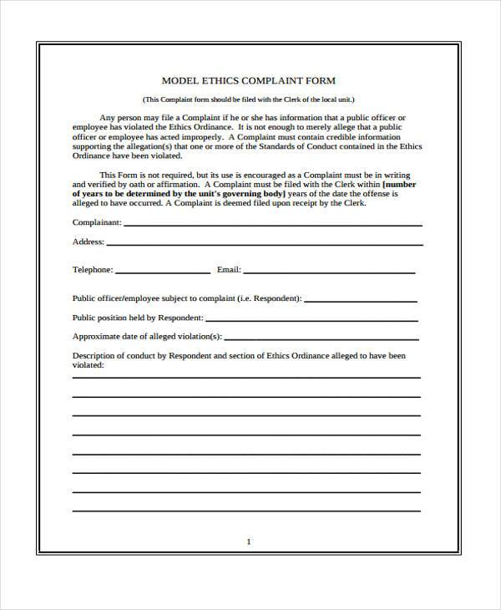
IMPLEMENTATION
How Are Complaints Filed?
Confidentiality considerations
Who Decides If There Has Been a
Violation?
Ethics Board
Legislative body
What is the Process?
Hearing or Meeting?
Notes:
60

Slide 61
Avenue for Redress
Can the offender appeal and, if so, to whom?
Who is the final arbiter?
Where employment is involved be wary of contractual obligations
Where appointments are involved be mindful of appointment rules and policies.
Notes:
61

Slide 62
Violations and Penalties
Possible repercussions include:
Termination of employment,
Removal from office,
Civil Fine
Censure, and
Possible voiding of contract, transaction or decision.
Notes:
62

Slide 63
New Britain: Enforcement and Penalties
The board shall have the power to investigate any reported allegations, to hold hearings and to provide specific recommendations of disciplinary action in accordance with city procedures and policies. The board of ethics shall report its findings to the common council as to whether or not a violation of this article has occurred, together with recommended sanctions to be imposed by the common council, unless city procedures and policies require that the matter be addressed elsewhere. Such report shall be filed with the city clerk with copies to the mayor's office and common council no later than one hundred eighty (180) days from the date on which the board of ethics is notified of the matter in question. Sanctions may include but are not limited to fines, termination of employment, suspension without pay, censure and/or reprimand. If the board believes an activity to be illegal, it shall report its findings to the appropriate authority for investigation.
Notes:
63

Slide 64
Violations and Penalties
Various criminal statutes can apply, including the following:
Larceny, including defrauding a public community of any value. Larceny in the first degree is a Class B felony.
See Conn. Gen. Stat. §53a-122.
Bribe Receiving. Class C Felony.
See Conn. Gen. Stat. §53a-148.
Receiving kickbacks. Class D Felony.
See Conn. Gen. Stat. §53a-161c.
Notes:
64

Slide 65
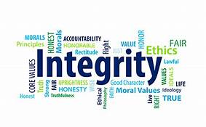
Parting Wisdom
When it comes to Ethics….
1. Remember the purpose of ethics rules
2. Know what rules or statutes specifically apply
3. Be introspective
4. Remember the appearance of impropriety
5. When in doubt – seek assistance
5. Always guard your integrity jealously
Notes:
65

Slide 66
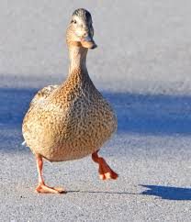
And Finally - When It Comes To Conflicts…..
IF IT WALKS LIKE A
Notes:
66

Slide 67
AND QUACKS LIKE A
Notes:
67

Slide 68
IT IS PROBABLY A…
Notes:
68

Slide 69
Notes:
69

Slide 70
Speaker Contact:
Kari L. Olson
Partner, Murtha Cullina LLP
p. 860-240-6085
e. kolson@murthalaw.com
Notes:
70

