Slide 1
MS4 Tasks & Stormwater Compliance
Presented by Chris Stone, P.E. and Nicole Kibbe
Stormwater Permitting, Compliance & Enforcement Program
Water Permitting and Enforcement Division
Bureau of Material Management and Compliance Assurance

Slide 2
Presentation outline
Small MS4 General Permit
Permit Overview
Minimum Control Measures
Proposed Permit Modifications
Stormwater Quality Manual
Overview of Major Updates
Other Happenings at DEEP
Question and Answer
Notes:
Overview of Slides

Slide 3
Stormwater Permitting
Stormwater runs over surfaces and collects pollutants, which can be transported – untreated – to our waterbodies.
EPA published a study that found stormwater runoff has the potential to collect a pollutant load resembling raw sewage and developed national regulations.
Phase I & II Stormwater Permits implemented to authorize stormwater discharges to waters of the state.
FOUR MAIN STORMWATER GENERAL PERMITS IN CONNECTICUT:
Commercial Stormwater General Permit
Construction Stormwater
General Permit
Industrial Stormwater General Permit
Small MS4
General Permit
Notes:
1972: EPA amends the Water Pollution Control Act (commonly referred to as the Clean Water Act) to regulate point source discharges
1983: EPA publishes the results of the NURP (Nationwide Urban Runoff Program) study which showed that Stormwater has the potential to collect such high pollutant loads that it resembles raw sewage.
1987: EPA amends the CWA to include non-point sources (like stormwater!)
1990: Phase I Stormwater Rule covered Industrial sites, large construction sites (5+ acres), and medium and large MS4s
1999: Phase II Stormwater Rule covered small construction sites (1-5 acres) and small MS4s

Slide 4
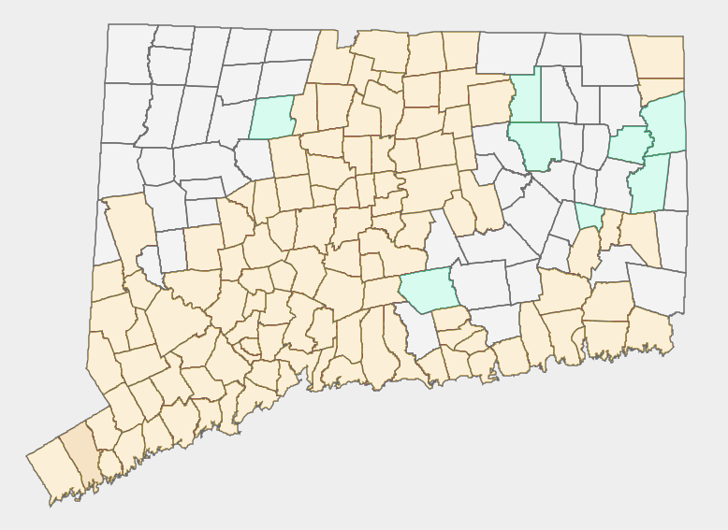
Small MS4 General Permit Overview
Permit History
1992: EPA Phase I Stormwater Rule
1999: EPA Phase II Stormwater Rule
2004: Small MS4 GP issued
2017: MS4 GP reissued with Modifications
2022: 2017 MS4 permit expired
2023: 2017 MS4 permit reissued without modifications
Permit Coverage
Under the 2004 permit: 113 Municipalities
Under the 2017 permit: 121 Municipalities, 12 Institutions
Permit coverage is determined based on the Decennial Census.
2004 MS4 Permittees
2017 MS4 Permittees
Municipalities not covered under the MS4 GP
Notes:
States are required to implement Small MS4 permits as a result of the EPA Phase II Stormwater Rule. While there are different levels of the permit based on the size of the MS4, CT only has Small MS4s (except the City of Stamford, which is covered separately under an individual permit) so we do not have a general permit for larger MS4s.
As of the 2017 permit, 121 municipalities are covered (approx. 72% of municipalities in the state).
Coverage is determined by decennial census. The 2020 census was finally released in full in Mid 2022.

Slide 5
The six Minimum Control Measures:
Public Education & Outreach
Public Participation
& Involvement
Illicit Discharge Detection &
Elimination
1
2
3
Impaired Waters Monitoring
Construction Stormwater Runoff Control
Post-construction Stormwater Runoff Control
Good
Housekeeping
4
5
6
Notes:
EPA separates most of the permit conditions into six general categories (Minimum Control Measures). Many of these tasks are part of the normal responsibilities of local government.
The six minimum control measures are:
MCM 1: Public Education & Outreach – establishes a program to educate the public about stormwater through outreach
MCM 2: Public Participation & Involvement – establishes a program to get the public involved in the permitting process
MCM 3: Illicit Discharge Detection & Elimination – establishes a program to detect and eliminate illicit discharges into your MS4
MCM 4: Construction Stormwater Runoff Control – establishes a program to control runoff from construction sites
MCM 5: Post-construction Stormwater Runoff Control – establishes a program to control runoff from sites after construction is complete
MCM 6: Pollution Prevention & Good Housekeeping – establishes a program to prevent pollution through good housekeeping practices
In addition to these measures, there are the impaired waters monitoring requirements, which monitor discharges to impaired waters.

Slide 6
Minimum Control Measures MCMs 1 & 2: Public Education & Participation
MCM 1: Public Education & Outreach Tasks
Implement a public education program
Public education programs often include:
Stormwater informational webpage
Mailed informational flyers
School programs
MCM 2: Public Participation & Involvement Tasks
Public availability of Stormwater Management Plan (SMP) and Annual Reports
Both the SMP and the Annual Reports should be available on your website!
Public Participation events
Community/volunteer projects, school projects, Household hazardous waste days, etc.
NOTE: Qualifying Local Programs (QLPs)
Many tasks in the MS4 permit can be performed by a third party!
Public Education & Outreach
1
Public Participation
& Involvement
2
Notes:
//Going over the general compliance tasks under each MCM first, and then we will go back and discuss common issues we see.
MCM1: maintain a dedicated webpage for Stormwater with educational materials
MCM2: make sure that both your SMP and your ARs are available on your website!
REMEMBER: Anything that exposes the community to any education on water or stormwater likely counts as either MCM 1 or 2. Don’t be shy about taking credit for things happening in your community.
QLP can do many of the tasks in the permit. Some QLPs include watershed groups, volunteer groups, scout groups, etc.
Keep in mind that the permittee remains responsible for making sure that tasks are completed on schedule.

Slide 7
Minimum Control Measures MCM 3: Illicit Discharge Detection & Elimination
MCM 3: Illicit Discharge Detection & Elimination Tasks
Develop written IDDE program
Establish and/or upgrade local authority to prohibit illicit discharges
System mapping
Outfall mapping of permittee-owned outfalls
Interconnection mapping
where your MS4 connects to neighboring municipalities, CTDOT, etc.
Systemwide mapping
Complete dry weather screening
Screening of all outfalls during dry weather for signs of illicit discharges
Outfall assessment based on results of screening
Outfall priority ranking (exempt, low, high, problem)
Catchment investigations based on priority
Illicit Discharge Detection
& Elimination
3
Notes:
Unlike the other MCMs, IDDE typically isn’t considered as a “normal responsibility of local government”, but it is still a part of maintaining and understanding your local infrastructure.
A written IDDE program or procedure allows DEEP and your own staff to understand how you are identifying illicit discharges.
Local authority ensures that you can legally carry out your IDDE plan.
System mapping (and especially interconnections mapping) is the basis for a lot of the conditions in the permit and allows you to target outfalls and catchment areas that may be doing poorly.
Dry Weather screening involves going around to all your outfalls after it has not rained in awhile to look for signs of illicit discharges. Seeing flow from an outfall after a week without rain may indicate a problem that needs fixing! Based on the results of your dry weather screening, you then must investigate potential issues you spotted.

Slide 8
Minimum Control Measures MCMs 4 & 5: Construction and Post-construction Runoff
MCM 4: Construction Stormwater Runoff Control Tasks
Establish and/or upgrade local authority to comply with Manuals and Construction GP
Review site plans and perform inspections of construction sites
Allow public comment on proposed site development
Notify developers of DEEP permit registration requirements
MCM 5: Post-construction Stormwater Runoff Control Tasks
Establish and/or upgrade local authority to require consideration of LID practices
Develop long-term maintenance plans for treatment structures and basins
Directly Connected Impervious Area Mapping
Develop DCIA mapping
Develop a baseline DCIA acreage for your municipality
DCIA acreage should be less than Impervious Cover acreage (tools provided by UCONN NEMO)
Construction Stormwater Runoff Control
4
Post-construction Stormwater Runoff Control
5
Notes:
Like MCM 3, MCMs 4+5 also rely on the permittee to have the right to enforce the regulations they enact.
MCM 4: covers active construction and focuses on controlling sediment runoff from these sites.
MCM 5: covers completed construction sites. This may be confusing as post construction clearly comes after construction, but the post-construction state of the site is planned before construction even begins. So post-construction tasks focus heavily on site planning and retention standards. This is where the baseline for DCIA tasks is established.

Slide 9
Minimum Control Measures MCM 6: Pollution Prevention & Good Housekeeping
MCM6: Pollution Prevention & Good Housekeeping Tasks
Develop and Implement a formal employees training program
MS4 property maintenance
Fertilizer reduction in parks and other areas
Pet & animal waste management in parks and other areas
Street sweeping schedule
Catchbasin cleaning schedule
Infrastructure repair, rehabilitation, and retrofit
Infrastructure repair
Retrofit program
DCIA disconnection tracking
Retrofit planning
1% retrofit goal
Review snow management practices
Good
Housekeeping
6
Notes:
Many MCM6 tasks are common sense practices – reduce fertilizer usage (to prevent nutrients from entering the system), reduce road salt usage (but not road safety) (to prevent salt from entering the system), sweep your streets (to prevent trash from entering the system), clean your catchbasins (to prevent trash from entering the system), repair your system before it breaks, train your employees to identify all these things so that you can be aware of issues before they grow.
The DCIA portion of this is planning for the future. We know impervious surfaces are a major contributor to SW runoff so, if we remove the pathway to the waterbody from these surfaces those pollutants cannot enter the waterbody.

Slide 10
Minimum Control Measures Other: Impaired Waters Monitoring
Impaired Waters Monitoring Program Tasks
Identify impaired waterbodies within your municipality
Identify the primary pollutant for each impaired waterbody
Nutrients (nitrogen / phosphorous)
Bacteria
Mercury
Other pollutants of concern
Identify outfalls which discharge directly to impaired waters
Perform wet weather screening for all outfalls which discharge to impaired waters
Screen all outfalls discharging to impaired waters by July 2022
Follow-up investigations for results exceeding permit thresholds
Impaired Waters Monitoring
Notes:
Impaired Water Monitoring is not one of the six minimum control measures; however, it is another major aspect of the permit.
The process here is pretty simple, but each task can become rather complex.

Slide 11
The six Minimum Control Measures:
Public Education & Outreach
Public Participation
& Involvement
Illicit Discharge Detection &
Elimination
1
2
3
Impaired Waters Monitoring
Construction Stormwater Runoff Control
Post-construction Stormwater Runoff Control
Good
Housekeeping
4
5
6
Notes:
We’ve gone over the general tasks for each of the MCMs – now we are going to go over common compliance issues we see within those tasks.

Slide 12
The six Minimum Control Measures:
Public Education & Outreach
Public Participation
& Involvement
Illicit Discharge Detection &
Elimination
1
2
3
Impaired Waters Monitoring
Construction Stormwater Runoff Control
Post-construction Stormwater Runoff Control
Good
Housekeeping
4
5
6
Notes:
The MCMs we see permittees having the most difficulty complying with are MCM 5 (IDDE) and MCM 6 (good housekeeping). Permittees are also having issues with the impaired waters monitoring requirements.

Slide 13
COMMON COMPLIANCE ISSUES Legal Authorities (MCMs 3, 4, & 5)
Example language provided by UCONN CLEAR
Municipalities are required to establish various legal authorities under:
MCM 3: Illicit Discharge Detection & Elimination
MCM 4: Construction Stormwater Runoff Control
and MCM 5: Post-construction Stormwater Runoff Control
Legal Authorities ensure that the permittee can complete various permit tasks such as:
Prohibit illicit discharges into their system and enforce the removal of such discharges
Perform inspections at construction sites
Require construction projects to confirm with the Stormwater Quality Manual
Require developers to consider Low Impact Development practices
Require additional control measures in order to protect their system and/or water quality
Legal Authorities must be an enforceable. They can be an ordinance, bylaw, regulation, standard condition of approval, or another appropriate enforceable legal authority.
Notes:
Establishing legal authority ensures that permittees are able to complete permit tasks. MCMs 3,4,+5 have associated legal authority requirements.
Many municipalities have expressed difficulty with establishing these authorities. UCONN CLEAR provides example language for these authorities on their MS4 webpage.

Slide 14
COMMON COMPLIANCE ISSUES Directly Connected Impervious Area (MCMs 5 & 6)
METRICS
Average Baseline DCIA: 1,100 acres
DCIA Disconnections:
Average: 0.7 acres
21 Municipalities have reached 1% goal
13 municipalities have reached 2% goal
Directly Connected Impervious Area (DCIA)
“[DCIA] means that impervious area from which stormwater runoff discharges directly to waters of the state or directly to a storm sewer system that discharges to waters of the state. Impervious areas that discharge through a system designed to retain the appropriate portion of the Water Quality Volume … are not considered DCIA.”
DCIA Retrofit Program
Develop baseline (completed in MCM 5)
Identify impervious cover
Apply Sutherland Equations to determine DCIA based on land use (provided by UCONN CLEAR)
Track redevelopment projects that disconnect DCIA
Disconnections can be from any project, both private and public
Disconnection credits can be used from as far back as 2012
Retrofit disconnection plan
Identify and prioritize disconnection projects
2% DCIA disconnection by 2022, 1% DCIA disconnection each year after
Good
Housekeeping
6
Notes:
DCIA spans both MCM5+MCM6. MCM5 focuses on the mapping portion while the rest of the program is in MCM6.
It seems that some municipalities may be equating Impervious Cover and DCIA. DCIA acreage should most often be significantly lower than IC acreage. The Sutherland Equations to Determine DCIA provide a ratio of IC to DCIA based on land use.
Any disconnections (both public and private) after 2012 can be counted towards your DCIA disconnection goal. This is because the mapping that the DCIA baseline is based on was completed in 2012.
DCIA Disconnections disconnect a property or a portion of a property (be it a road or a site) from the MS4. Permittees should have come up with a plan to prioritize projects which would accomplish this.

Slide 15
COMMON COMPLIANCE ISSUES Illicit Discharge Detection & Elimination (MCM 3)
METRICS
61% of municipalities have a Written Plan
System Mapping:
~70% have completed Outfall Mapping
~30% have completed Interconnection Mapping
~45% have completed Systemwide Mapping
Illicit Discharge Detection and Elimination Compliance Issues
Develop written IDDE program
System mapping
Interconnection mapping
where your MS4 connects to neighboring municipalities, CTDOT, etc.
Systemwide mapping
Complete dry weather screening
Screening of all outfalls for signs of illicit discharges
Outfall assessment based on results of screening
Outfall priority ranking (exempt, low, high, problem)
Catchment investigations based on priority
Illicit Discharge Detection
& Elimination
3
Notes:
The IDDE program as a whole has seen may difficulties. It can be time and resource intensive.
Interconnections Mapping is important because, if you discharge into another MS4 and that MS4 discharges to the river – its not your discharge anymore. You should coordinate with that other MS4, but the responsibility for the outfall lies with them.
Screening during dry weather leads to awareness of discharges which then must be investigated. Outfalls should be ranked on a priority scale based on potential threat to the environment.

Slide 16
COMMON COMPLIANCE ISSUES Impaired Waters Monitoring (other)
Impaired Waters Monitoring Program Issues
Identify impaired waterbodies within your municipality
Reminder: the Integrated Water Quality Report (IWQR) is updated every two years
Identify outfalls which discharge directly to impaired waters
Outfalls discharging into an interconnected system (such as DOT’s) and then into the impaired waterbody are not the responsibility of the municipality so long as the interconnection is documented
Perform wet weather screening for all outfalls which discharge to impaired waters
Screen all outfalls discharging to impaired waters by July 2022
“Who performs screening?”
Timing of sampling
Especially bacteria samples
Follow-up investigations for results exceeding permit thresholds
Impaired Waters Monitoring
Notes:
IDDE monitoring and IW monitoring are different sampling schemes. IDDE is done during dry weather for ALL outfalls while IW is done during wet weather for outfalls that discharge to impaired waters.
Because it is dependent on the weather, wet weather monitoring is difficult for all of our permittees (not just our MS4 permittees).
Screening can be performed by anyone, but the permittee ultimately holds responsibility for ensuring that it is done.
For any outfalls with results exceeding the thresholds set in the permit, a follow-up investigation must be performed to determine the cause of the pollutant load.

Slide 17
COMMON COMPLIANCE ISSUES Annual Reports (general)
Permittees are required to submit a report detailing their compliance efforts over the past year.
Reports are due April 1 each year and must be available for public comment for 30 days prior to submittal.
Annual Report Templates are available on the Stormwater webpage for both New and Existing permittees
A detailed annual report is a good annual report!
Re-read the permit and your Stormwater Management Plan (SMP)!
Compare the permit requirements with the timelines you laid out in your SMP!
Compare what you’ve done over the past year with your SMP!
Explain discrepancies!
Include lots of detail!
Annual Reports must be signed by a chief elected official or principal executive officer, as well as the person who prepared it.
Notes:
Annual reports provide, in detail, everything that the permittee has done for their MS4 in the past year. Due to this, they are extremely helpful for determining compliance. If no report is received it is a permit violation AND we will have to assume that nothing was done for the MS4 over the past year.
Be as detailed as possible! Reread the permit requirements from time to time to ensure that you are doing everything you need to be!

Slide 18
Determining MS4 Compliance
Compliance is primarily determined through Annual Reports and inspections.
Annual Reports
Annual Reports are very useful for documenting what has been accomplished each year and permit term, both for individual permittees and to understand overall compliance of all MS4 permittees.
Inspections
In-person inspections provide much more insight into individual permit compliance.
DEEP aims to inspect every MS4 permittee about once a permit term.
Inspections are decided randomly
Inspectors will contact you ahead of time to set up a meeting time and place
Expect the MS4 inspection to take about half a workday
Notes:
As mentioned previously, Annual Reports are very helpful compliance tools. We rely on them a lot so the better and more detailed they are, the more we can understand your efforts.
DEEP performs random inspections several times a year. We aim to inspect each of our permits about once a permit term. Inspections are typically random.
Inspections are as much of a chance for us to talk to you as they are a chance for you to talk to us, so use the opportunity to ask questions and get clarification! What we hear from permittees influences future modifications to the permit.
EPA has expressed an interest in EJ Communities in recent years, so expect a greater focus on these communities.

Slide 19
Updates to the MS4 Permit
The permit is back in effect!
Reissued with no modifications until September 30, 2025
Annual Reports due April 1st, 2024
DEEP wants your feedback!
DEEP Staff are actively working on modifications to the permit.
To better understand the current state of the MS4 permit, DEEP will be holding a Listening Session for permittees, shareholders, and members of the public.
Provides a venue to voice comments and concerns about the current permit and speak to what you would like to see in the modified permit
Listening Session will be scheduled for late 2023 or early 2024
Details will be sent to permittees and stakeholders, but any member of the public is invited to attend
Comments received from the Listening Session will be considered while finalizing permit modifications.
Notes:
DEEP will be treating the year the permit lapsed as an additional year for permittees to come into compliance. Annual Reports due 4/2024 must cover Oct 2023 to Dec 2023, but permittees are highly encouraged to include everything since their last report.
We are actively working on modifications to the permit. We will be holding a listening session to discuss high level changes and commentary we receive will be incorporated into the final draft of the permit.

Slide 20
STORMWATER QUALITY MANUAL
UPDATES
Notes:
Moving on! Next is a high level overview of changes to the Stormwater Quality Manual

Slide 21
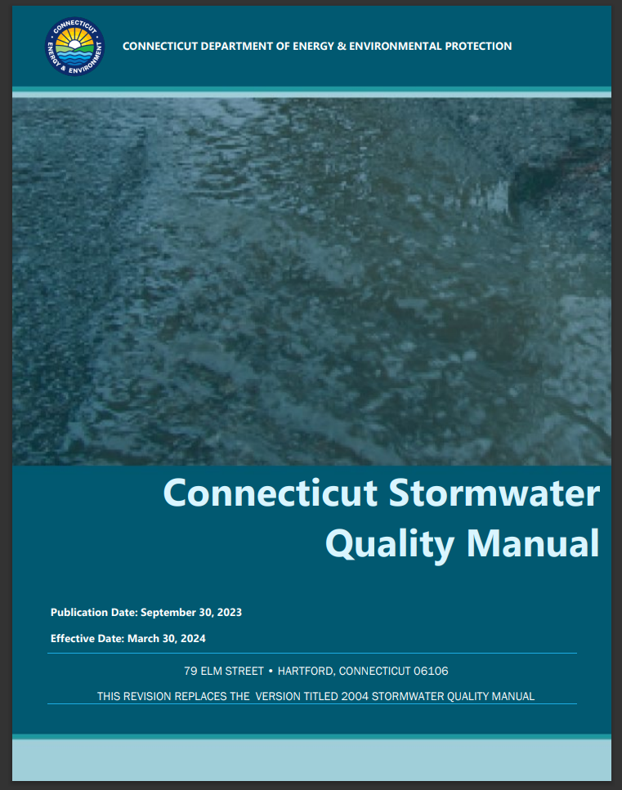
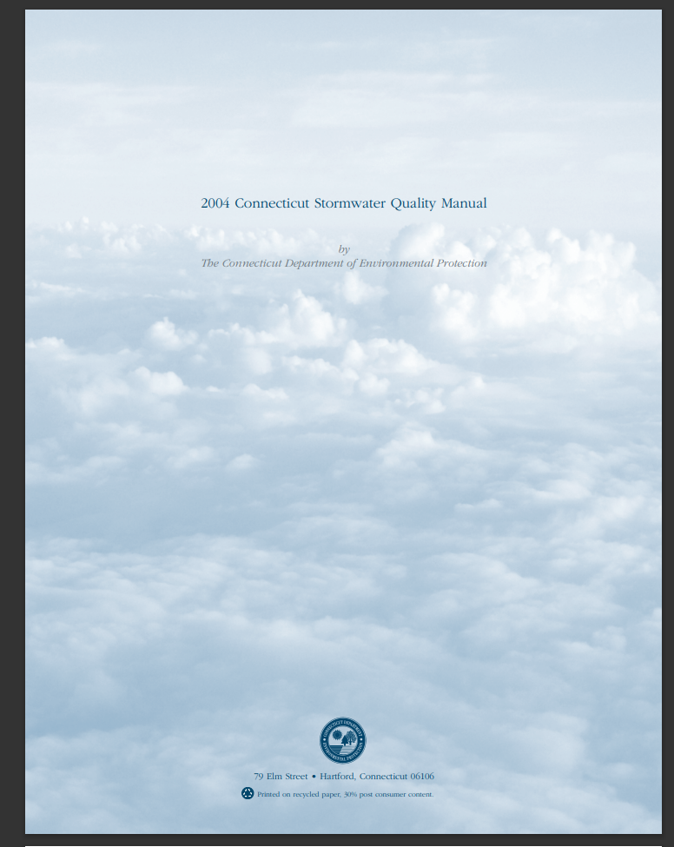
CT Stormwater Quality Manual Updates
“The Connecticut Stormwater Quality Manual provides guidance on the measures necessary to protect the waters of the State of Connecticut from the adverse impacts of post-construction stormwater runoff.”
The Stormwater Quality Manual focuses on:
site planning,
source control, and
stormwater treatment practices.
It is intended for use as a planning tool and design guidance document.
2023 updates to the Stormwater Quality Manual supersede the
2004 Stormwater Quality Manual.
Notes:
The Stormwater Quality Manual provides guidance statewide for use primarily in construction projects.
2023 Updates supersede the previous version of the Manual.

Slide 22
CT Stormwater Quality Manual Updates Major Goals & Changes
Improve coordination between the Stormwater Quality Manual and the Erosion and Sediment Control Guidelines.
Improve consistency with DEEP permits.
Improve climate resiliency.
Design Quality Storm (DQS) and Water Quality Volume (WQV) updated to reflect latest NOAA data
DQS is based on historical data of the 90th percentile rainfall volume; 1 inch in 2004, 1.3 inches in 2023
Enhance Low Impact Development (LID) guidance for design and implementation.
New chapters dedicated solely to LID and infiltration design guidance
Updated retrofit guidance
Make guidance provided in the manual more function driven.
Flow of process emphasized (LID then retention then treatment)
BMP guidance expanded and more function-driven
Updated standards to provide site-specific flexibility
BMP selection guidance enhanced with flow charts and BMP performance curves
Plant appendix redesigned to point to more exhaustive (and more frequently updated) databases
Notes:
Updates had 5 major goals:

Slide 23
CT Stormwater Quality Manual Updates
IMPLEMENTATION PHASING:
Sept. 30, 2023
March 31, 2024
Sept. 30, 2024
MANUAL IS PUBLISHED
Get familiar with the new guidelines and update current practices.
Update local regulations and authorities.
EFFECTIVE DATE
Adopt updated guidelines for new projects.
GRACE PERIOD BEGINS
for projects which have completed preliminary design.
GRACE PERIOD ENDS
Adopt updated guidelines for all projects.
Notes:
The updates will be phased in over the next year. As of now the Manual is published. People are welcome and encouraged to adopt these updates early, but not required until the Manual becomes effective.
The Manual becomes effective in March 2024 with exceptions provided to projects which are already in progress.
These exemptions end at the end of September 2024, after which all projects must adopt the new guidelines, regardless of project status.

Slide 24
Other Happenings at DEEP
Connecticut Guidelines for Soil Erosion and Sediment Control also updated!
Same implementation schedule as the Stormwater Quality Manual
New England Retrofit Manual published July 2022!
Provides guidance on planning, siting, and designing retrofit stormwater control measures to manage stormwater in existing or reconstructed development situations
Also presents an approach for crediting pollutant and runoff volume reductions associated with these measures
New Division Director & Asst. Director!
Audra Dickson, Director of the Water Permitting & Enforcement Division
Michelle Gore, Assistant Director of the Water Permitting & Enforcement Division
Stormwater Monitoring Reports (SMRs) can now be submitted electronically!
Please be on the look out for instructions on the Industrial Stormwater webpage
Updates to the Industrial and Commercial Stormwater General Permits in progress!

Slide 25
Questions?
Chris Stone, P.E.
CT DEEP Stormwater Program
860.424.3850
Chris.Stone@ct.gov
Nicole Kibbe
CT DEEP Stormwater Program
860.424.3846
Nicole.Kibbe@ct.gov
P
P
E
E

