Slide 1
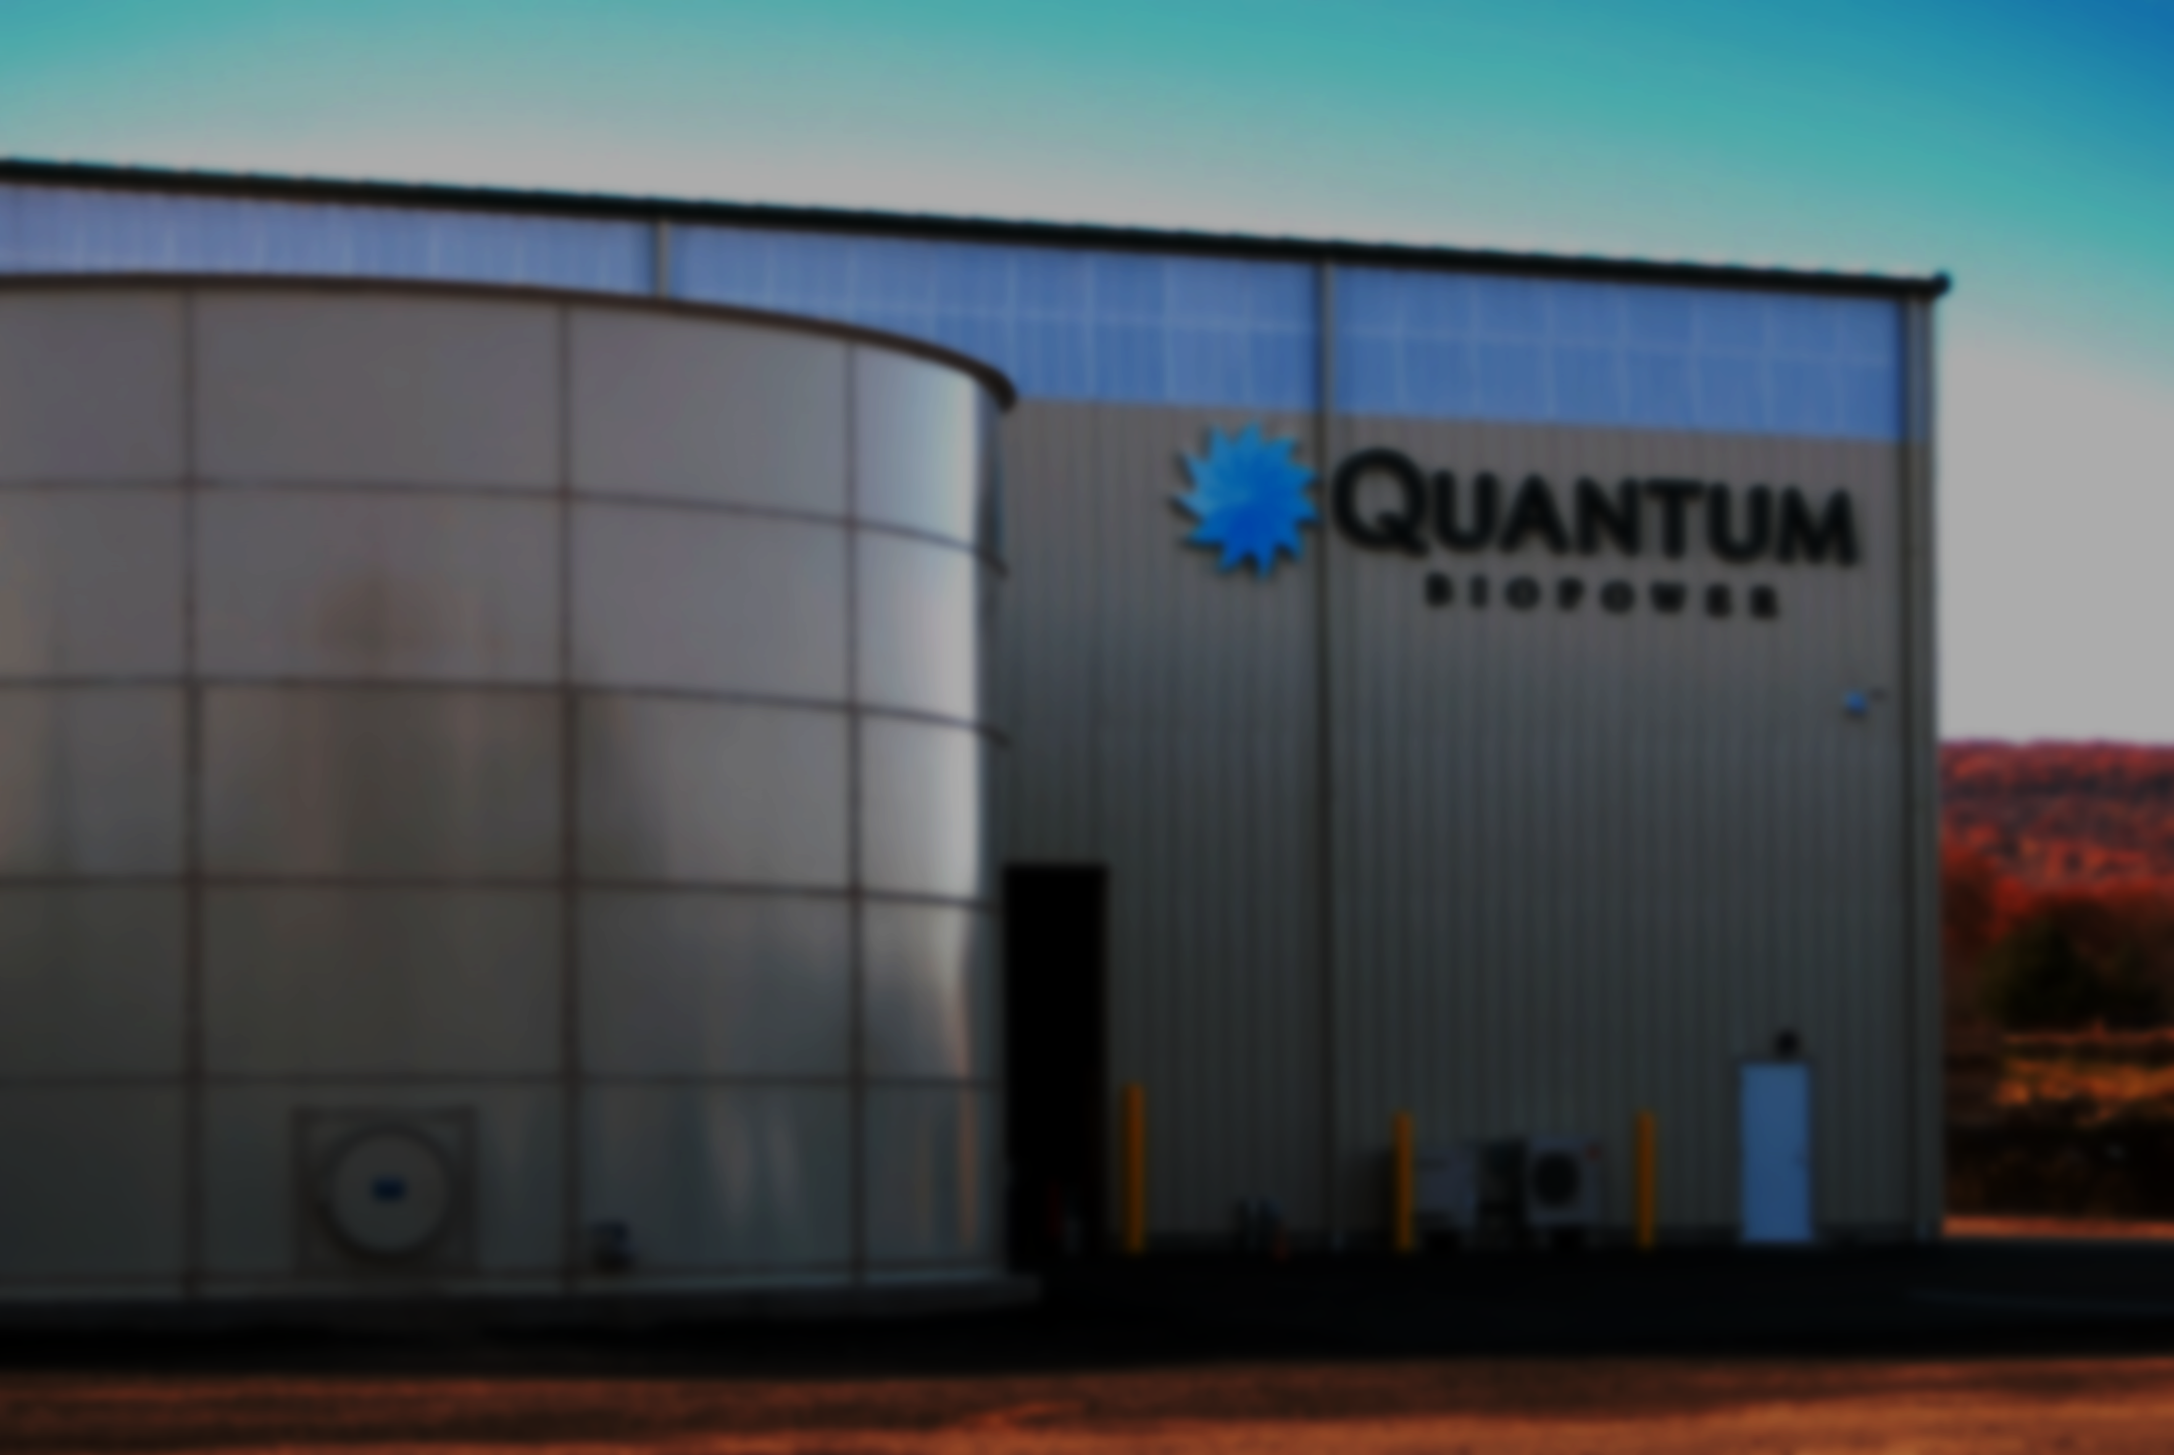
Food Waste To Energy
COST
Energy & Environment Conference

Slide 2
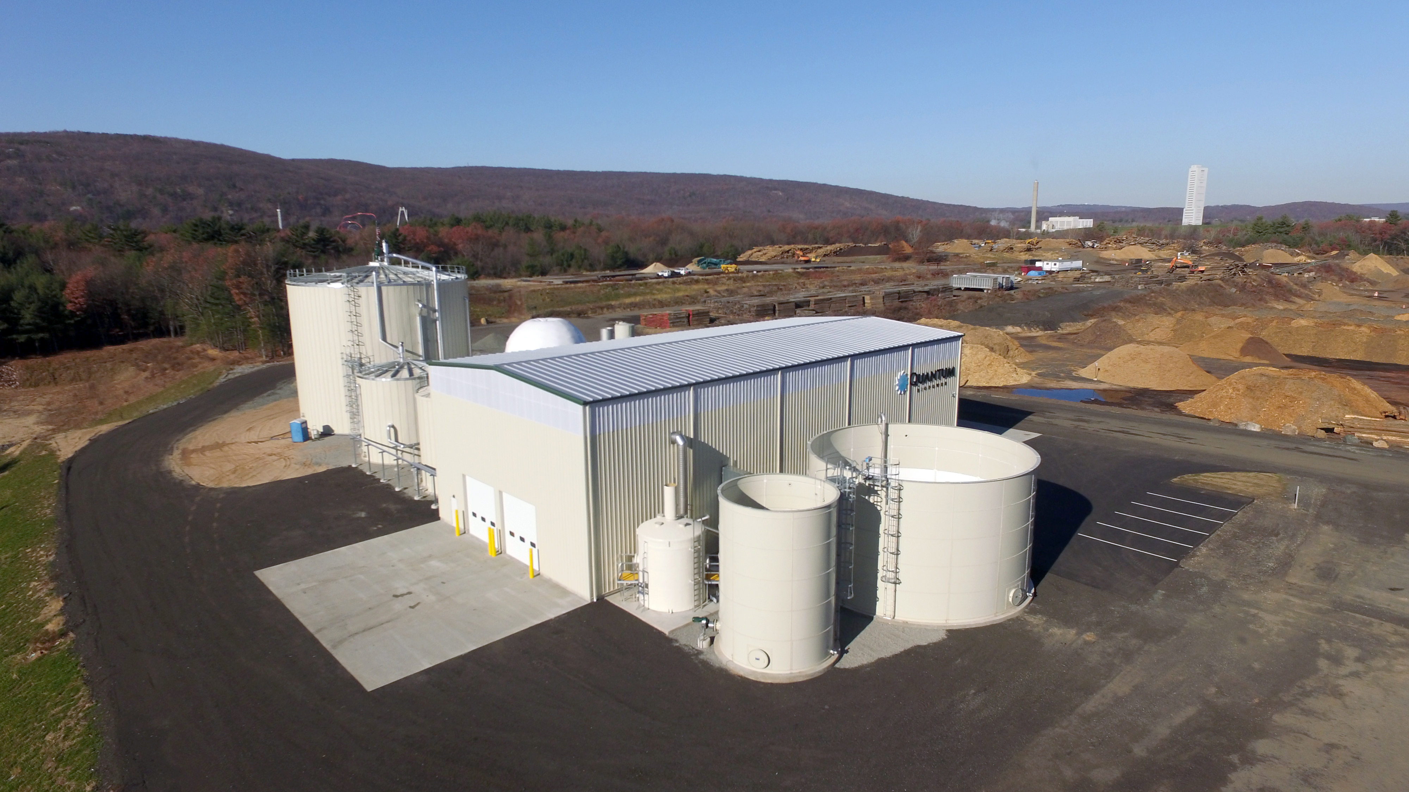
Quantum Biopower Operates The Most Sophisticated Biogas Facility On The East Coast.
Food Waste To Energy
Southington, CT
Pre-consumer food waste
Packaged waste goods
Municipal food waste
40,000 Tons
of food waste
10,700 MWh
of electricity
5,080 Tons
of avoided emissions
8,000 Tons
of compost created
Notes:
We make two things from Quantum.. Compost and Electricity…
In our 5th year of operation this facility is a nationally recognized facility – because of its leading edge technology and overall operation.
Simply put, no one processes food waste better than us in the State of CT.
If you are planning on growing award winning tomato’s this year, than we have the compost for you..

Slide 3
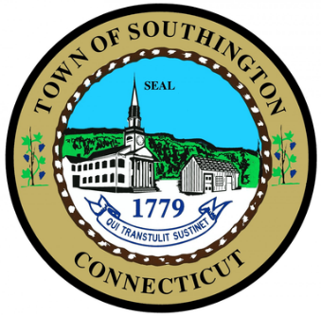
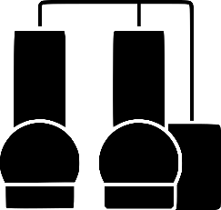
Our Community Benefits From Our Electricity
5 Beneficial Accounts in Southington
20 year agreement
Average – 20% savings on annual utility bills

Slide 4
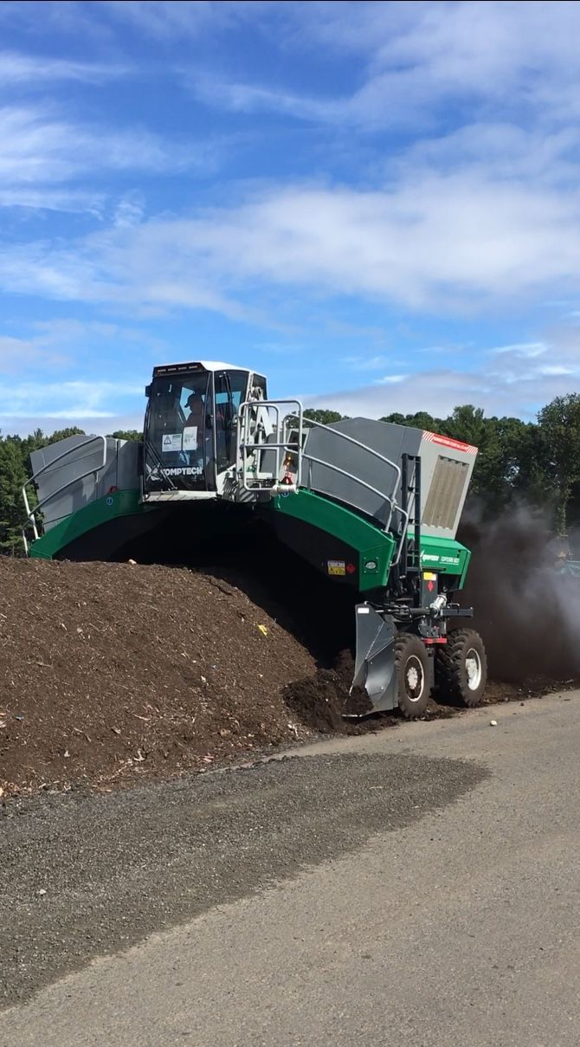
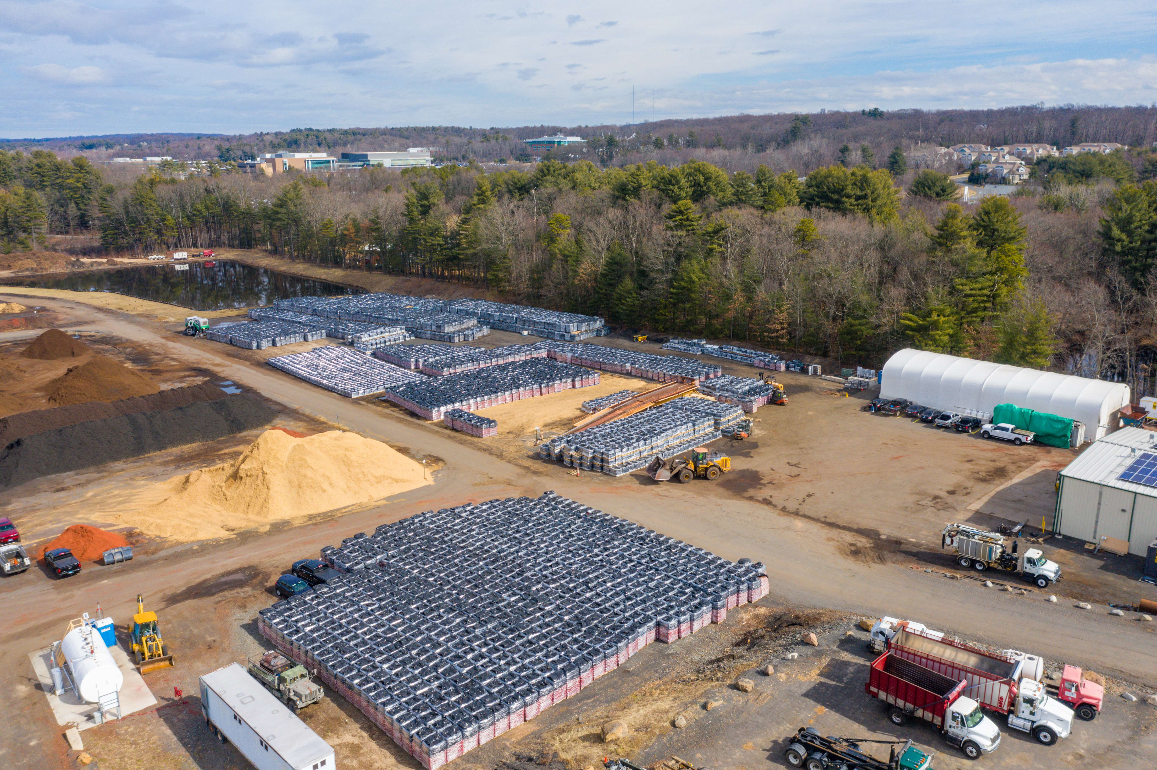
Market Leading Compost Blend Created From Food Waste
Digester Solids
Finish Composting
Bagging
Data Driven Results
Notes:
Differentiating factors for digestion versus other WtE tech is that we produce a usable soil amendment as a result of our process.
We unlock the nutrients (nitrogen, phosphorous, potassium) that are within food waste and turn them into compost and soil.
We are now applying what we learned to being more specific about food waste…
From a siting perspective…

Slide 5
Our Facility – Siting Impacts
DEEP Permitted
Solid Waste, Air, Wastewater
Local Permits
+/- 3 acres - compact
Minimal truck traffic – 5-7/day
Vertical tanks and steel building
Quiet - inaudible from 100 ft.
No odors – reverse air capture system
Notes:
Since this is an energy and environment conversation, we must discuss WHY we’re so heavily focused on food waste today.
Much of that focus is directly related to the collapse of our State’s WtE strategy.. Our incineration plants.

Slide 6
EfW Facility Woes Drive Food Diversion Needs
Connecticut is the most dependent state in the Northeast on Energy from Waste facilities.
1.42
2.12
4.64
Tons per person
Tons per person
Tons per person
$300+/MW
EFW ENERGY CONTRACTS
$40+/MW
1980’s
Notes:
Connecticut feels it the most when incineration capacity goes offline in the State… We’re feeling it now.
A strategy that was cultivated in the early 80’s, supported by legislation, strategy, with clear signals to the private market about the direction the State wanted to pursue.
Not a coincidence that the economics associated with operating waste to energy facilities is tied to one of its chief revenue drives, energy sales!
This clear market signal in the 80’s prompted groups to lay out capital for energy from waste technology.
If you build a piece of critical infrastructure, we will make sure your cost of capital is supported with stable energy pricing.
We don’t have to look further than our neighbor to our West, NY, to see what our fate is going to be for disposal.
Last year, NY’s chief export from its state was its waste, to the tune of billion’s of dollars per year in associated costs. With disposal rates well north of $140/ton.
So, as capacity for waste tightens, rates go up, the focus moves towards food waste.

Slide 7
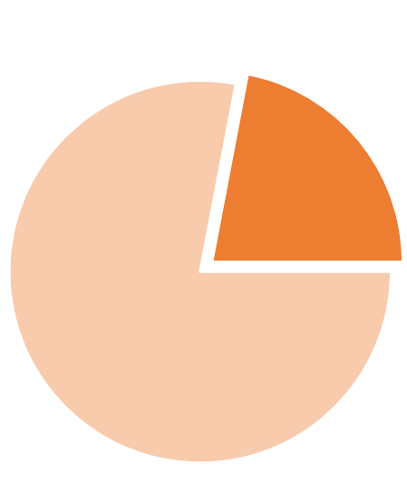
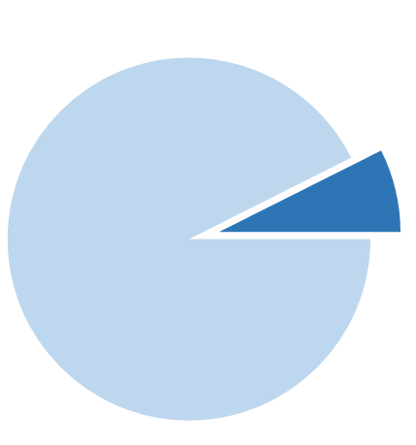
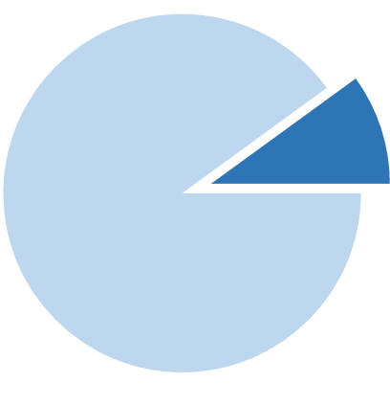
State Food Diversion Mandate Is Falling Short
22%
FOOD WASTE
(500K TONS)
15%
40K TONS
40K Tons
FOOD WASTE
2.5MM TONS
MSW
500K Tons
FOOD WASTE
FOOD WASTE IN THE STATE WASTE STREAM
QUANTUM’S CAPACITY TO PROCESS FOOD WASTE IN THE STATE
FOOD WASTE BEING GENERATED FROM STATE DIVERSION MANDATE AT QUANTUM
Notes:
Because food waste is the largest part of the waste stream that isn’t recycled in CT.
We play a small part in the recycling of food waste.
But the issue is the diversion mandates we have in the State are barely putting a dent in recovering food waste from our waste stream.
Mostly because of lack of enforcement and lack of incentive.
It will be quite challenging for more digesters to be built in Connecticut without a clear sense of where additional food waste streams are going to come from.
Without more food waste, its difficult to attract capital to develop and build.

Slide 8
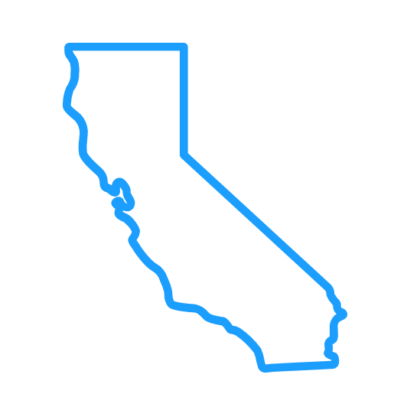
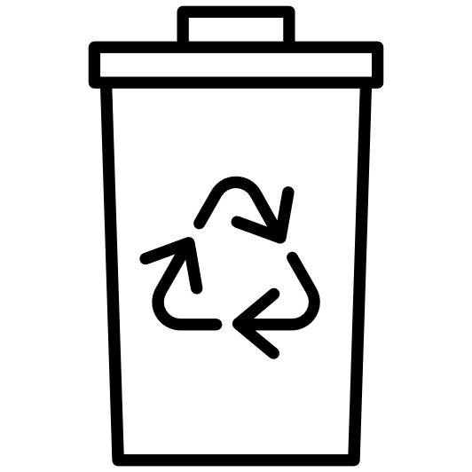
Its Time For Proper Food Diversion Programs
Mandatory diversion sends a clear market message to developers and investors. Shoring up waste streams is critical to the financing process.
SB 1383
Requires the mandatory diversion of food waste within counties, away from landfills into recycling facilities and food recovery organizations.
FINANCING
CA established a $250MM finance & granting mechanism to support food diversion programs and recycling infrastructure.
Curbside or Co-collected organics offers the best pathway to generating clean organic waste that is usable post digestion
Notes:
WE have an opportunity to recycle more commercial food waste in our backyard..
California example – California will divert 75% of its food waste from landfill in 5 years
35 anaerobic digesters planned for CA in the next 5 years.
The best and highest use for energy generation is curbside collected, or co-collected food waste.
These sorts of organics are of the highest purity and are most able to be re-used as compost after the digestion process.
Curbside programs are not without their challenges.

Slide 9
The Barriers To Success For Municipal Food Diversion
Good Food Separation
Transportation
Generate good quality organic waste suitable for composting and/or digestion.
Coordination between communities to reach critical volumes of food waste.
Education is vital.
Many examples of curbside diversion programs exist in parts of the world; Italy, Germany, UK, etc.
Technology is such that digesters can now accept higher contamination rate material that would be generated from such programs.
Community partnerships for collection and transportation of food waste is key to stabilizing costs.
In other parts of the world, separate collection vehicles, running on biogas, collect food waste in short radius’ around digesters.
Co-collection model is being piloted in certain communities, such a Meriden.
Collecting bagged food waste in the same collection container as garbage.
Notes:
If I were governor for the day…

Slide 10
Future Of Digestion In Connecticut
249
Existing biogas
Systems in North America
Connecticut Needs To..
Revise the Solid Waste Management Plan. Send very clear signals to the marketplace.
Establish incentives for companies wanting to invest in recycling infrastructure; PPA’s, REC’s, Carbon offset measures, etc.
~8,000
Get serious about food diversion mandates, either enforce or incentivize.
Potential biogas systems in North America
Support economic systems that put the financial value of food diversion back into citizen’s pockets.
Notes:
You cannot expect private companies to make big financial bets on unsure strategy… Start with sending a clear message.
Be a student of history.. What ignited our waste revolution in the 80’s was structured power agreements for waste.
Well we don’t want to incentivize burning of garbage or putting RNG in our pipes.
This is nonsense.. And whatsmore, those notions are unique ONLY to the State of Connecticut.. You don’t hear this in other parts of the world..
Around the entire world communities are building beautiful new infrastructure.

Slide 11
Thank You

