Slide 1
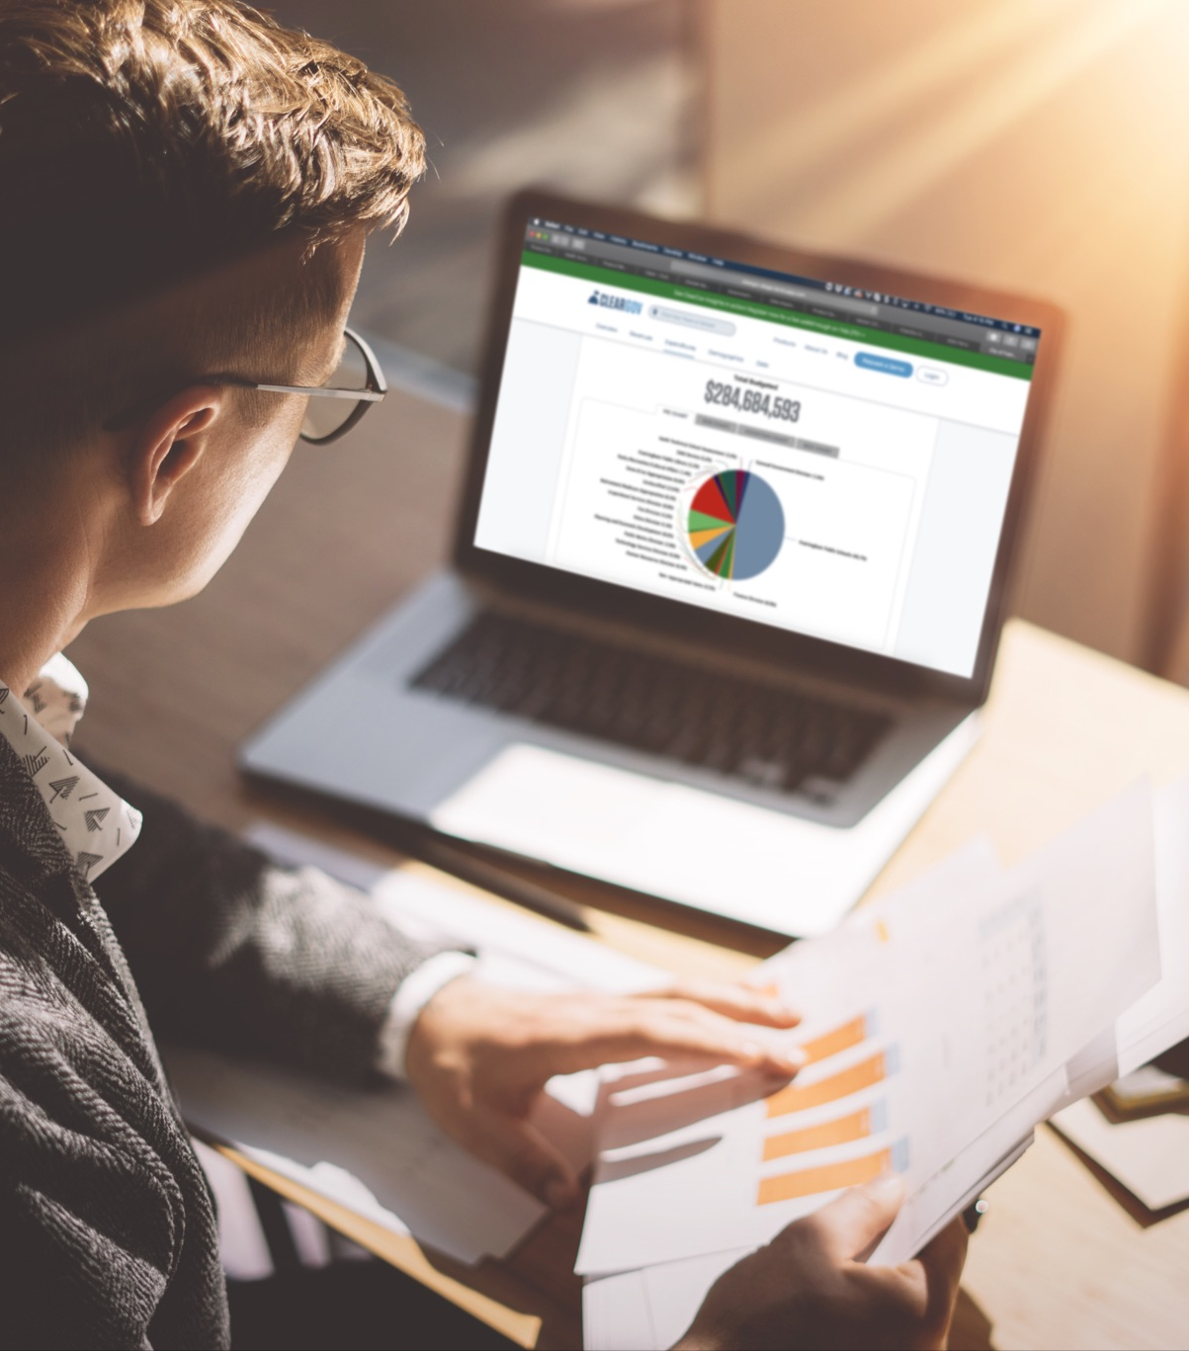
Modernizing the budget process for smaller municipalities
Presenter:
Rob Battaglia
Senior Market Development Executive @ ClearGov
Moderator:
Kathryn Dube
Director of Membership & Administrative Services @ COST

Slide 2
Guest Speakers
Tony Genovese, Town of Woodbridge
Rob Buden, Town of Plainville
Cindy Varrichio, Town of East Haddam

Slide 3
Webinar Agenda
Introduction and background
Roundtable discussion: Common budget cycle challenges
ClearGov product demonstration

Slide 4
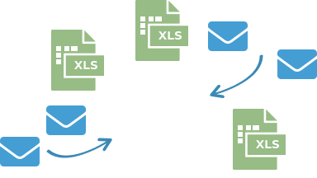
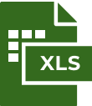
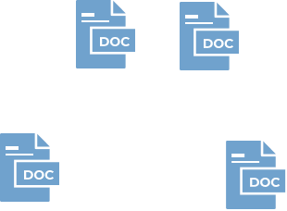

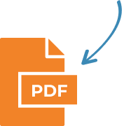
Legacy Budgeting Cycles are Inefficient
Operational Budget
Scattered
Documents, emails, notes, etc. are spread across multiple inboxes and desktops.
Capital Budget
Modernization is a Must!
Disjointed
Excel, Word and email are distinct, generic products that inhibit collaboration.
Tedious
Constructing, combining and correcting multiple spreadsheets is taxing, tiresome and time-consuming.
Budget Book
Personnel Budget
Notes:
Start with Excel, that multiple spreadsheets versions are required, and that email is used for communication and workflow.
Then talk about having to do this 3 times (Capital, Personnel and Operational).
Finally we need to produce the budget book.
Does this sound like your world?

Slide 5
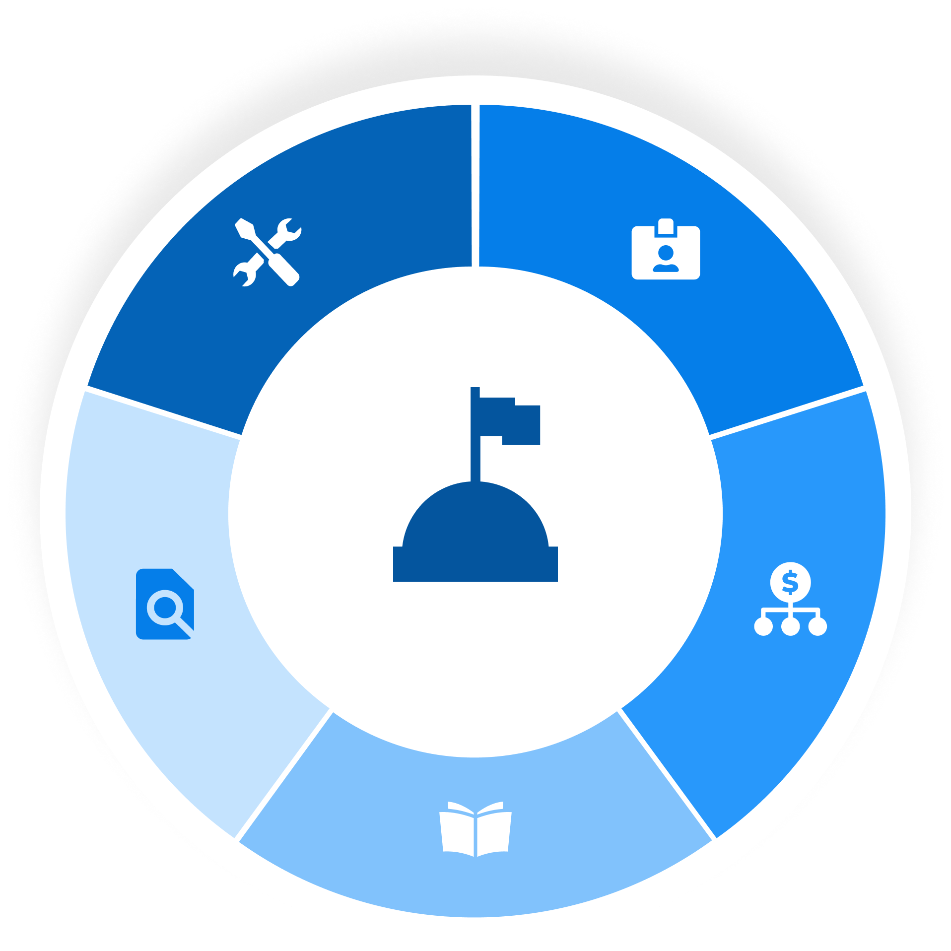
Budget Cycle Management Suite
Capital Budgeting
Automate the way you collect, organize and optimize capital utilization
Personnel Budgeting
Salary management, scenario planning and what-if analysis
Transparency
Tell your financial story to drive community support
Operational Budgeting
Build your forecast and annual budget more efficiently and collaboratively
Digital Budget Book
Produce an interactive and award-winning budget book in a fraction of the time

Slide 6
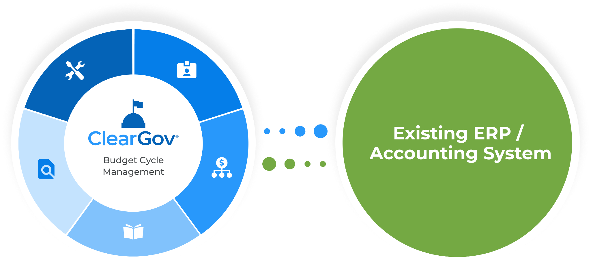
Complements Your Current Platform
ClearGov Budget Cycle Management
Easy to Move Data In
ClearGov will onboard your accounting data
Easy to Move Data Out
Export budget information into current system

Slide 7

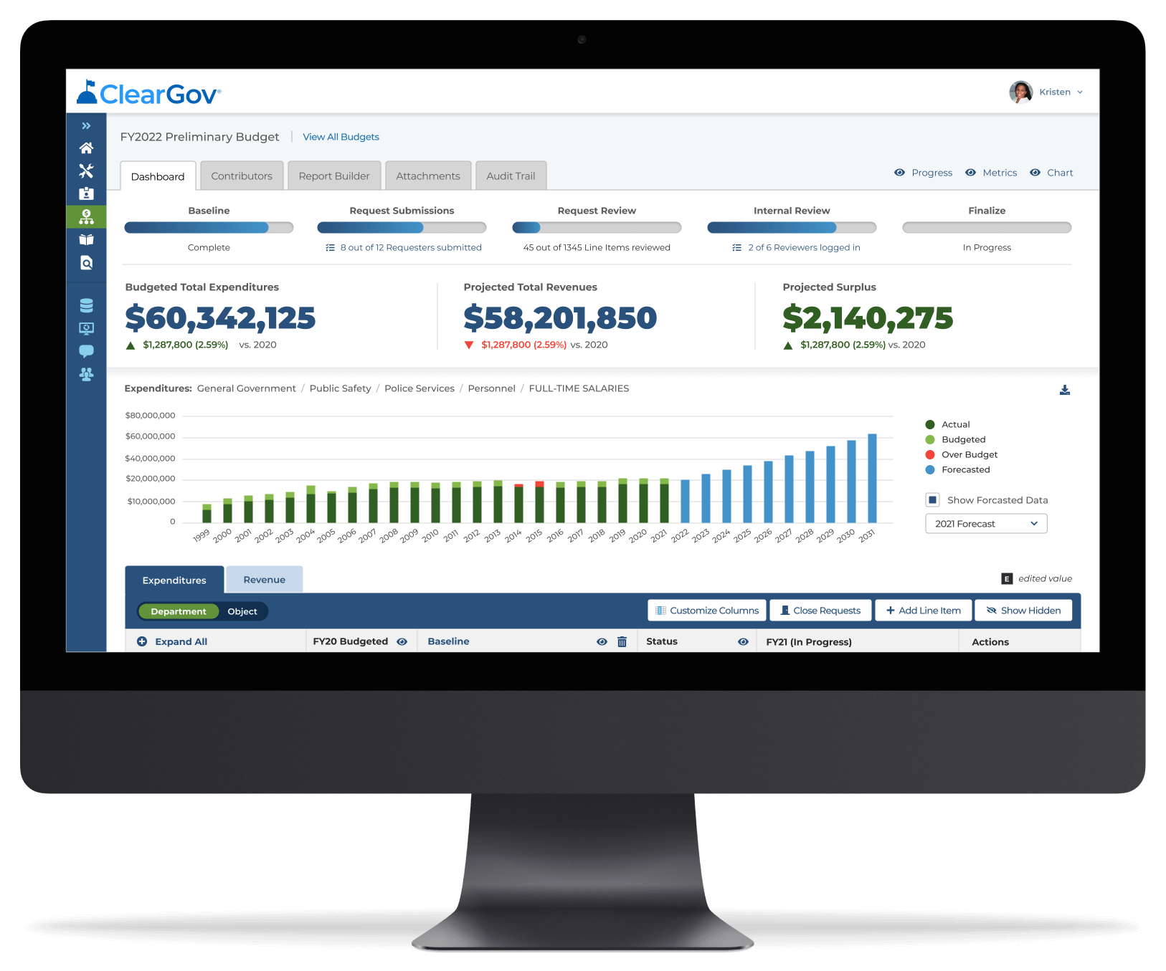

Operational Budgeting | Product Overview
Collaborative budgeting software that streamlines communication with department heads and other budget stakeholders. A one-stop shop to dynamically forecast what-if scenarios, build a budget and communicate budgeting rationale.
Operational Budget Dashboard
Quickly see and share the status of your budget-building process. Filter on current and historical financial data. Automatically aggregate all budget requests in one place.
Centralized Communication
Add comments, documents and supporting information to any line item. All content is centralized to streamline your budget review and communication process.
Departmental Collaboration
Easily assign department budgets and invite department heads to submit requests and rationale. Easily track request and review status and send automatic reminders.
Audit Trail
All budget edits are automatically tracked and stored within an audit trail. Easily review the historical record of budget decisions and communication.
AI Driven Forecasting
Sophisticated yet easy-to-use AI module enables you to create unlimited forecasts. Easily modify assumptions at the category level and instantly see the impact.
Report Builder
Create and export custom reports to share your operational budget with internal and external stakeholders and existing systems.

Slide 8

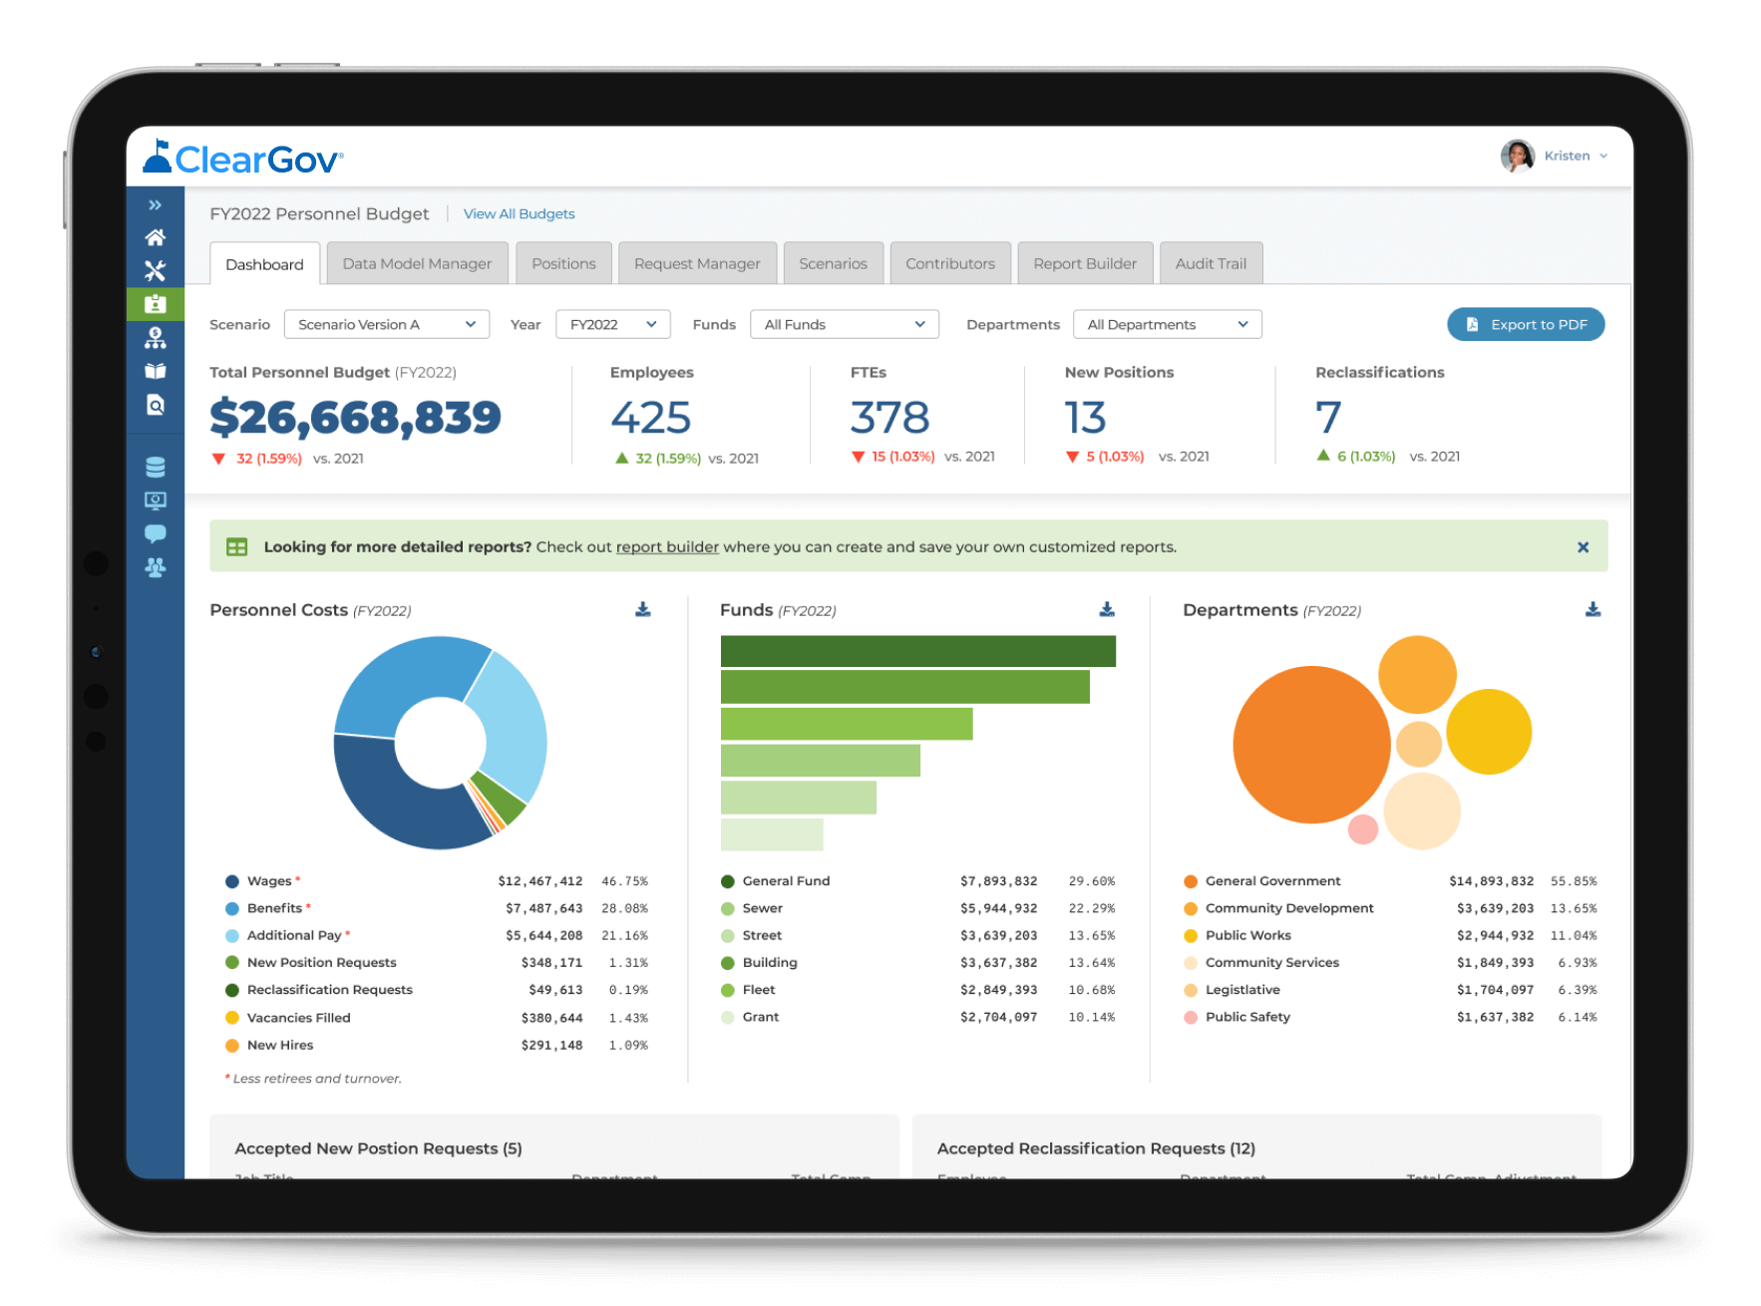
Personnel Budgeting | Product Overview
A unique software platform built specifically to help finance directors more easily budget for salaries and benefits. Complete with powerful tools to manage position requests, inform union negotiations and much more.
Personnel Dashboard
Get a bird’s eye view of staffing stats, as well as visually compare salary and benefits budgeting scenarios.
Union Negotiation Planning
Analyze the effects of adjustments to salaries and benefits for more informed negotiations.
Position Request Manager
Streamline position and reclassification requests with our customizable request forms and management system.
Multi-year Personnel Plans
Automatically create salary and benefit plans for up to twenty years in the future.
Vacancy Planning
Budget well into the future with the ability to create and fill vacant positions on specified dates.
Report Builder
Create and export custom reports to share your personnel budget with internal and external stakeholders and existing systems.

Slide 9

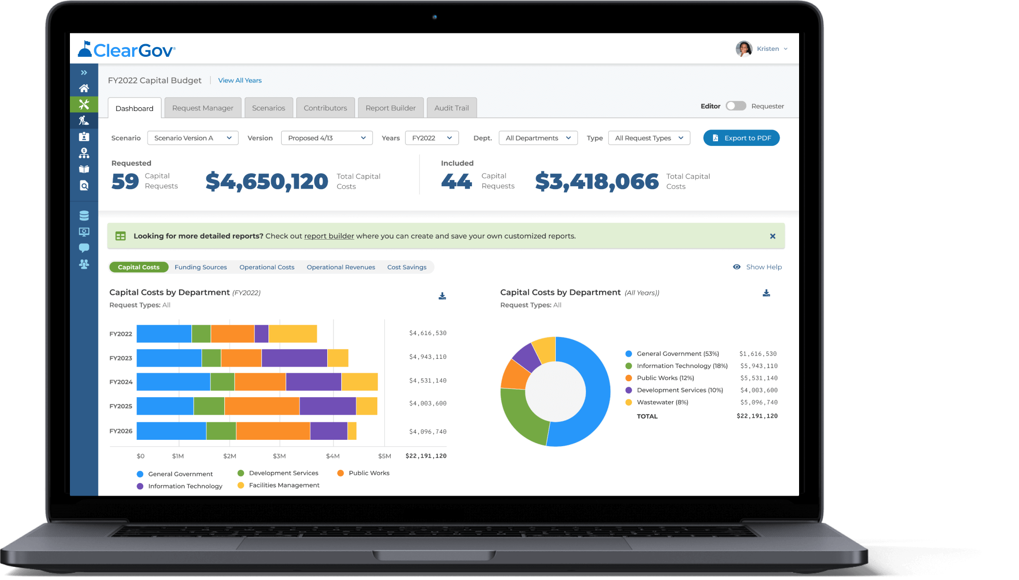
Capital Budgeting | Product Overview
The first cloud-based capital improvement planning (CIP) solution specifically designed for local governments that streamlines requests, provides a multi-year scenario optimization process, and generates website-based pages automatically for each capital improvement.
Capital Plan Dashboard
Gain a bird’s eye view of all capital improvement and equipment requests complete with the ability to filter by department and request type.
Scenario Planning
Create unlimited multi-year scenario plans to find the optimal capital utilization that fits within your budget.
Capital Request Manager
Invite department heads to submit capital requests with budgetary information, timelines, attached documents and more. Requests automatically feed the dashboard.
Report Builder
Create and export custom reports to share your capital budget with internal and external stakeholders and existing systems.
Request Scoring & Ranking
Score and rank capital requests based on custom criteria to prioritize requests, drive data-based decisions and communicate the capital planning process.
Capital Improvement Website
Better communicate your capital projects to internal and external stakeholders via a shareable, dynamic, map-based website with detailed project pages.

Slide 10

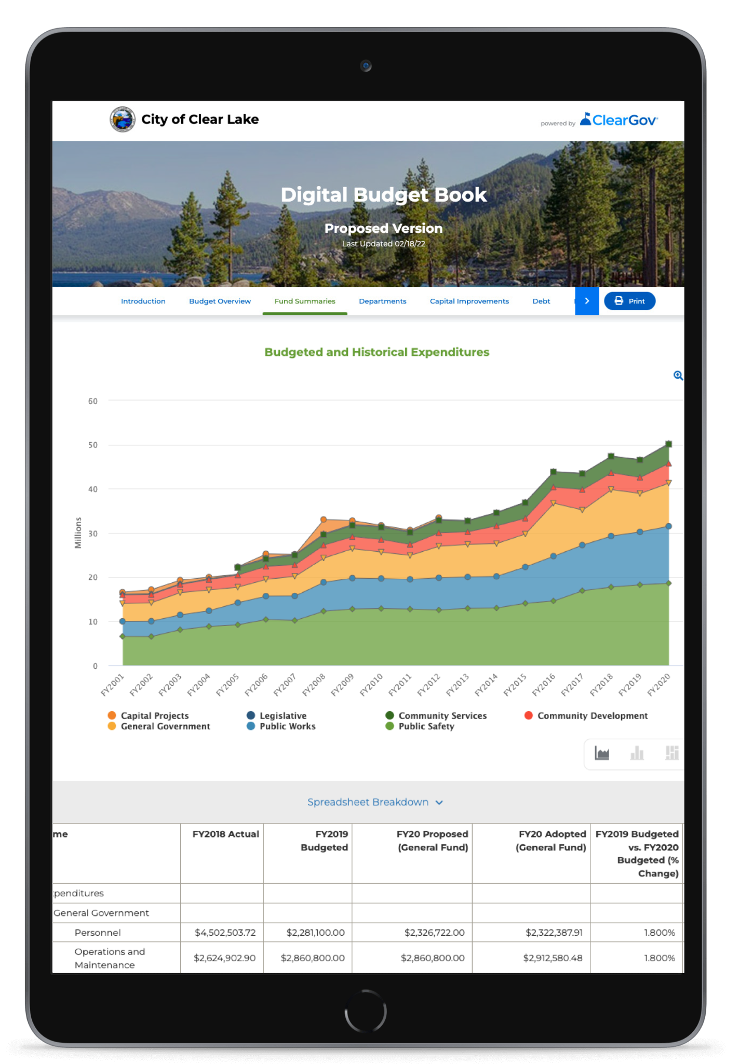
Digital Budget Book | Product Overview
The industry’s first website-based solution that automates most of the budget book creation process using templates and data-driven charts and tables. Meet GFOA award criteria and deliver new levels of clarity, engagement and understanding for your citizens.
Built-in GFOA Best Practices
Built-in GFOA framework and templates auto-create key sections and pre-populate them with data. Simply
add your narrative to complete an
award- winning budget book.
Collaborate and Customize
Invite department heads and other stakeholders to edit key sections of the budget book. Customize and control how your budget data is displayed and shared with the public
Automated Fund Summaries
Auto-generate pages for each fund in
your budget, pre-populated with revenue, expense and historical data.
Capital Improvements Inclusion
Automatically add annual and multi-year capital improvement plans directly into your digital budget book.
Department Specific Pages
With a few clicks build department pages, including auto-updating revenue and expenditure data. Invite department heads to add context, narrative and strategic goals.
Automatic Data Updates
Revenue and expense data are automatically updated as your budget changes, eliminating errors and saving time. Really valuable for those last-minute tweaks.

Slide 11

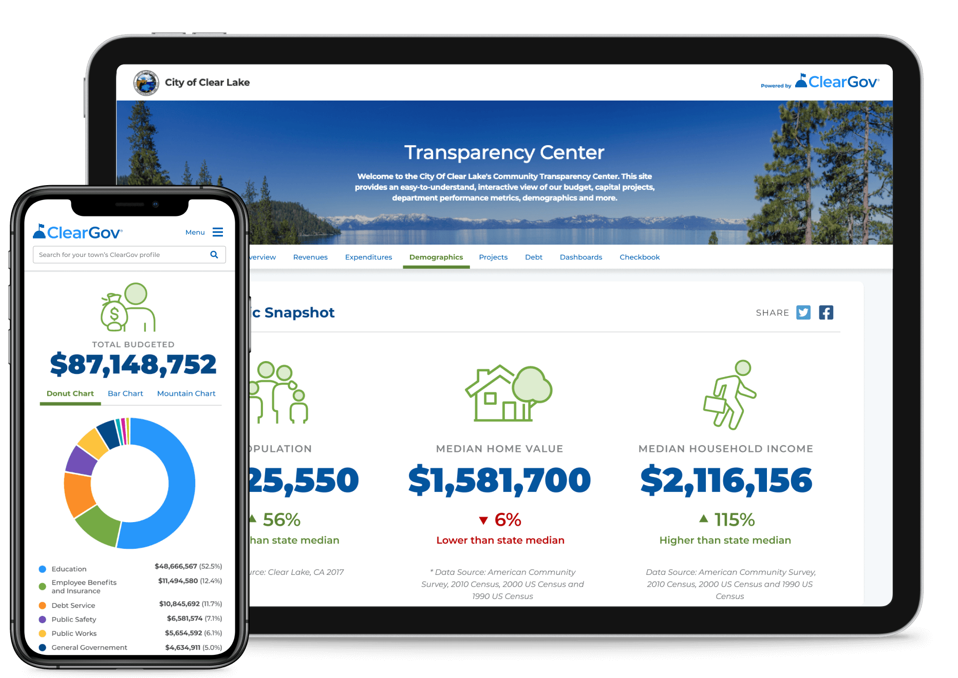
Transparency | Product Overview
Tell your financial story using our simple-to-navigate transparency center. Easy-to-understand infographics help you share financial information, departmental goals, and results in a way that informs and engages your community.
Financial Story
Help internal stakeholders and residents easily visualize and interpret important fiscal metrics to drive community support.
Peer Comparisons
Integrated peer group comparisons bring your data to life and provide critical context to close the communication gap.
Open Checkbook
At your option, deliver searchable check-level detail to help build public trust, dispel misconceptions, and increase accountability.
Department Dashboards
Easily create custom dashboard pages for each department to showcase the key benefits you’re driving for you community.
Custom Chart Builder
Easily build dynamic financial, performance, and custom charts to display throughout the public profile.

Slide 12











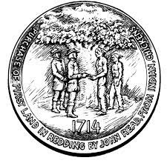



Your Connecticut ClearGov Community

Slide 13

Budget Cycle Challenges Discussion

Slide 14

Product Demonstration

Slide 15
For More Information:
ClearGov for Connecticut: Rob Battaglia
Phone: 631-747-3253
Email: rbattaglia@cleargov.com
Want to learn more about ClearGov? Schedule a demo

