Slide 1
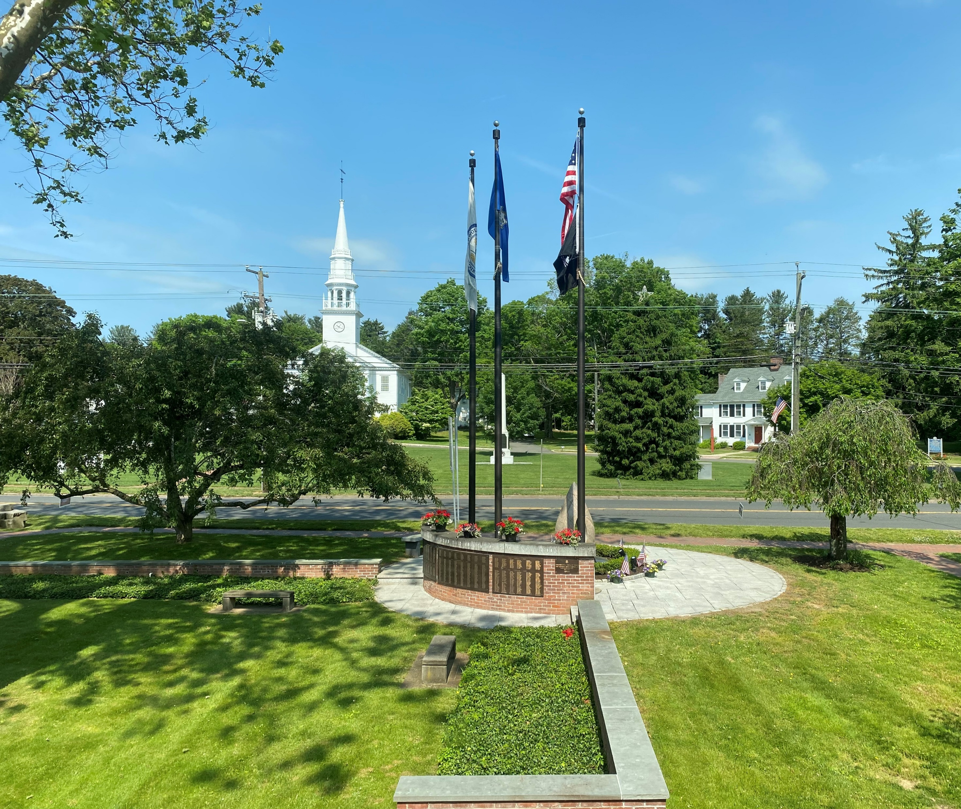

COST
Local Economic Development Strategies
Town of Cheshire
Andrew Martelli
Mike Glidden

Slide 2
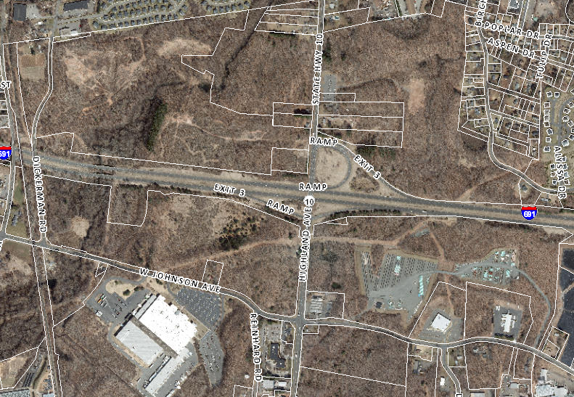

Slide 3
What TIF does
Establishes the Original Assessed Value of the District, the value baseline
Measures assessed value changes each year and the cumulative increases, or Tax Increment
Calculates and captures some or all of the revenues from the Tax Increment
Returns unused money to the General Fund
Tax Increment Financing Process
Identify a district
Identify potential public projects
Estimate revenues from increased assessed values, including
From new private investment
Make policy choices on revenue capture, capital plan, duration of
district, tax reductions for private business
Adopt through local process
Manage over time: identify, collect, and spend revenues,
complete public projects, Town Council votes on tax reduction
requests
TIF captures revenues but all expenditures go through
regular budget process

Slide 4

TIF is not a new tax or a special assessment
on top of the existing property tax.
TIF does not replace ordinary budgeting and
approval processes.

Slide 5
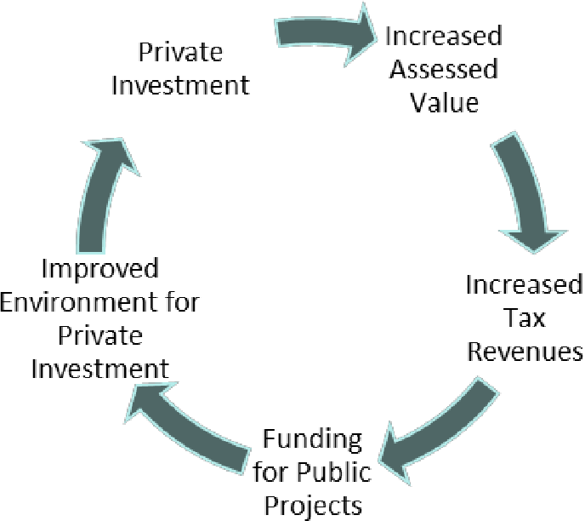
Why Use TIF?
Public projects and private investment work together in the same district Community’s development goals and priorities are communicated Long term planning is enhanced Can be paired with targeted financial assistance to desired private projects

Slide 6
Interchange Zone TIF
Established the land boundaries and assessed value baseline
Measures assessed value changes each year and the
cumulative increases, or Tax Increment
Calculates and captures 75% of the revenues from the Tax
Increment for authorized projects: “TIF Revenues”
25% of new tax revenues go to Town’s General Fund

Slide 7
Credit Enhancement Agreements
Credit
Enhancement
Agreements
(CEAs)
An optional tool that can be enabled in a TIF District
Enabled in a TIF District by State statute
Essentially an agreement between a developer and the host community for a Project to capture TIF revenue for TIF District Improvements
Cheshire received a CEA in August of 2021 for a major development based on approved Master Plan for parcel within TIF District
CEA outlined developers responsibility for infrastructure installation with repayment agreement
Business owes and pays 100% of taxes due on the property each year
If the “development” complies with all terms, such as job targets, grand list growth etc. a portion of taxes paid on incremental increases to assessed value are returned to developer to pay for infrastructure enhancements
Rebated taxes form a cashflow for businesses that can make it easier to get bank financing for project
Legislative body approves all CEA

Slide 8
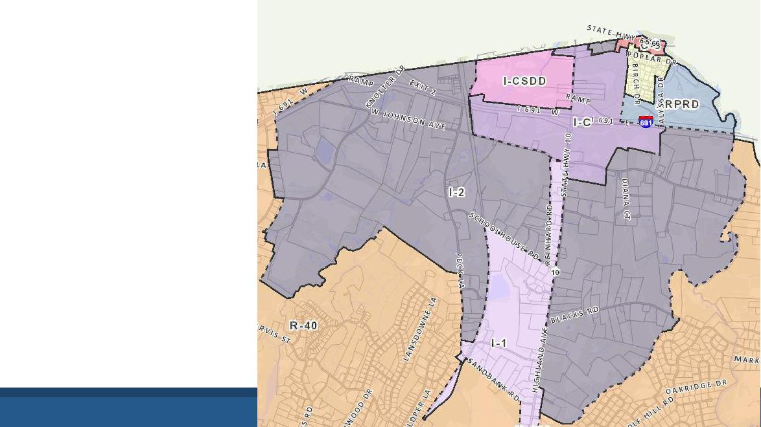
Interchange
Zone
TIF District
Master Plan

Slide 9
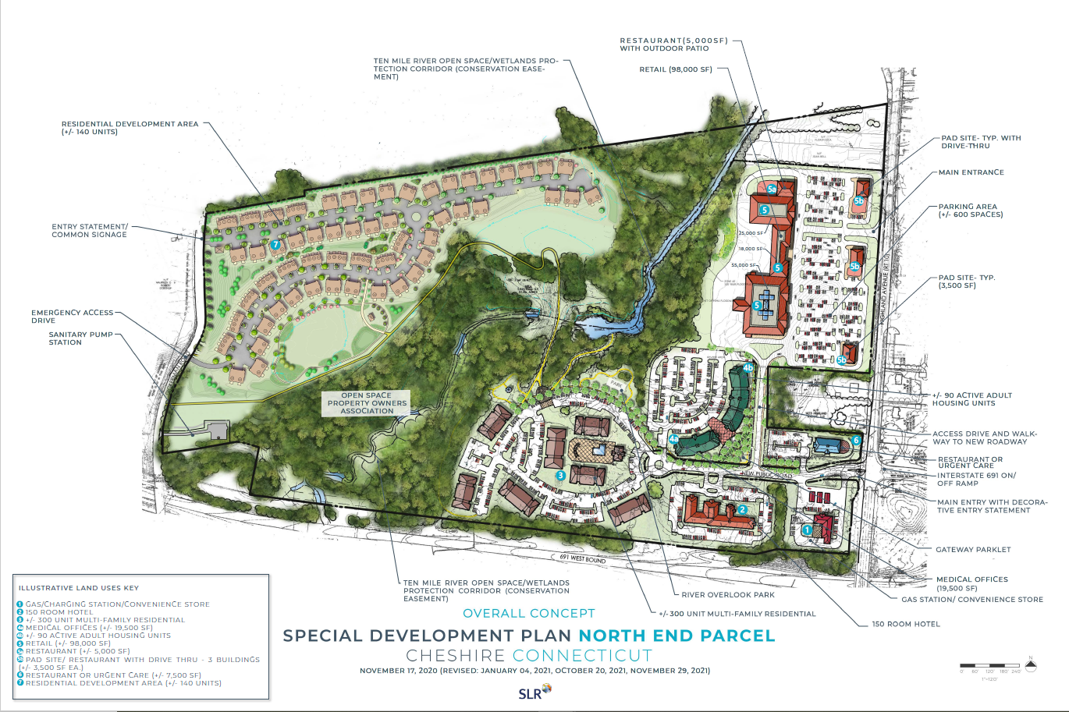
Stone Bridge Commons Development

Slide 10
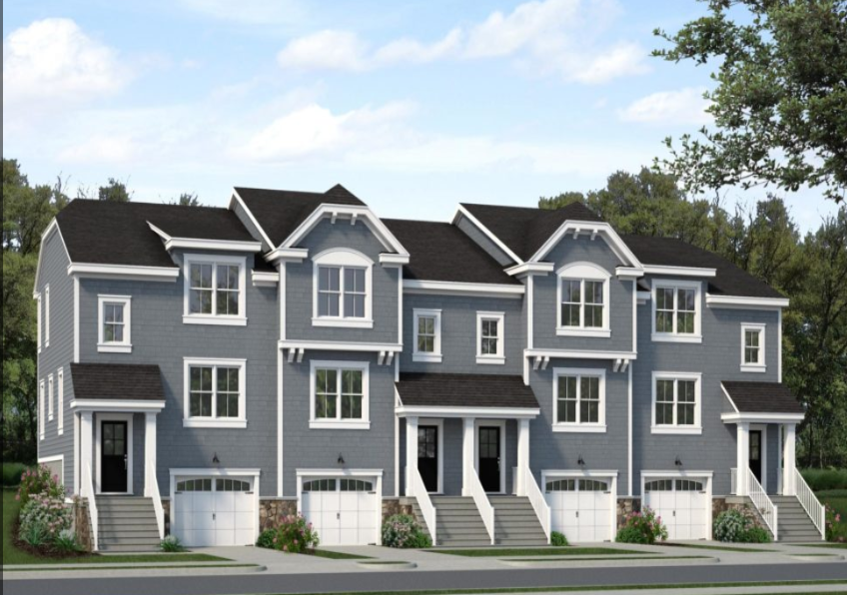

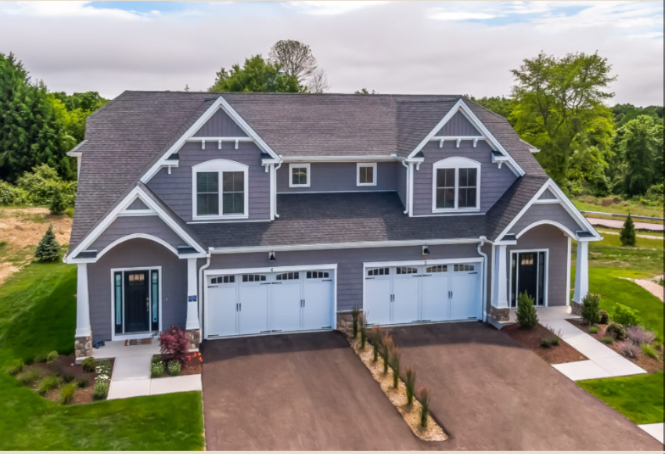

Slide 11
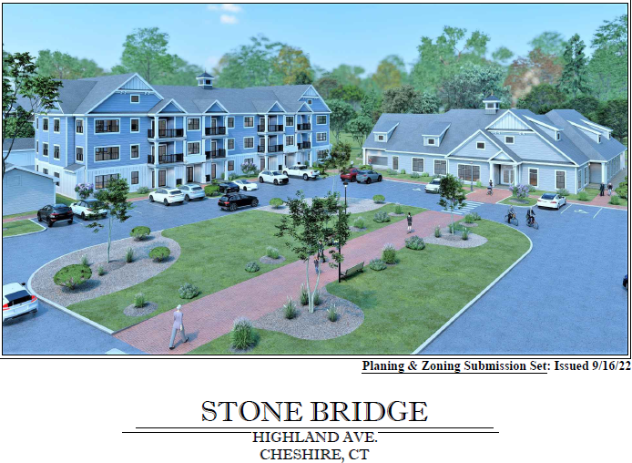
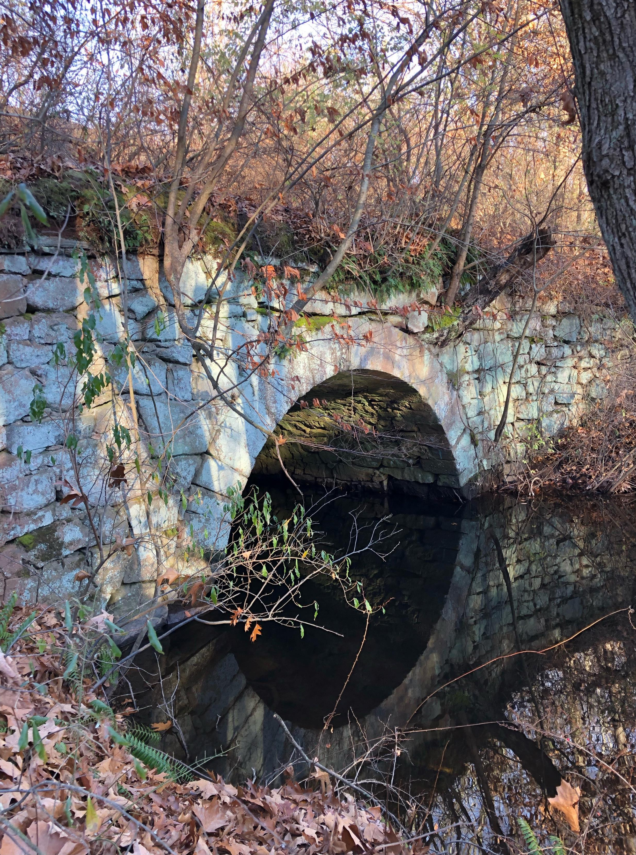

Slide 12
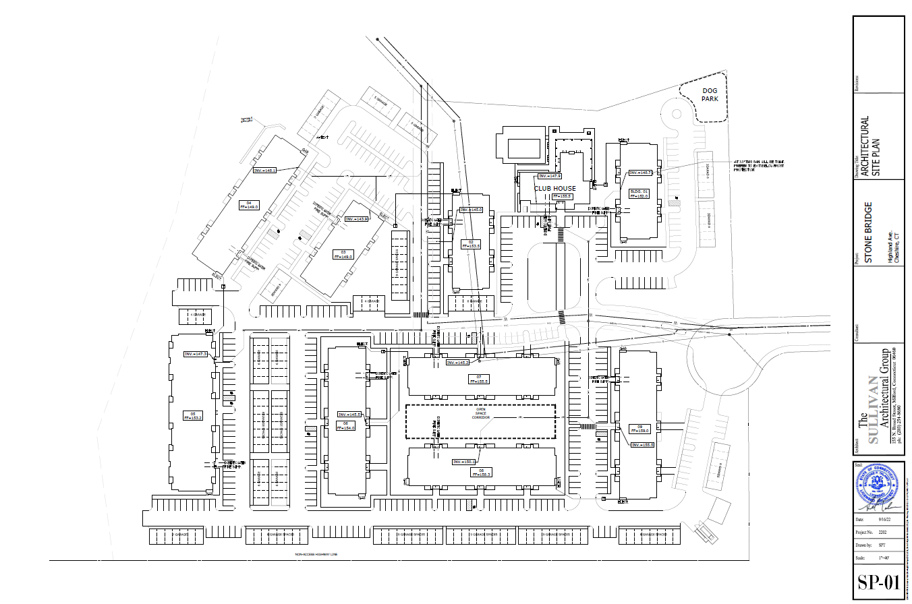

Slide 13
Stone Bridge Commons Development

Slide 14
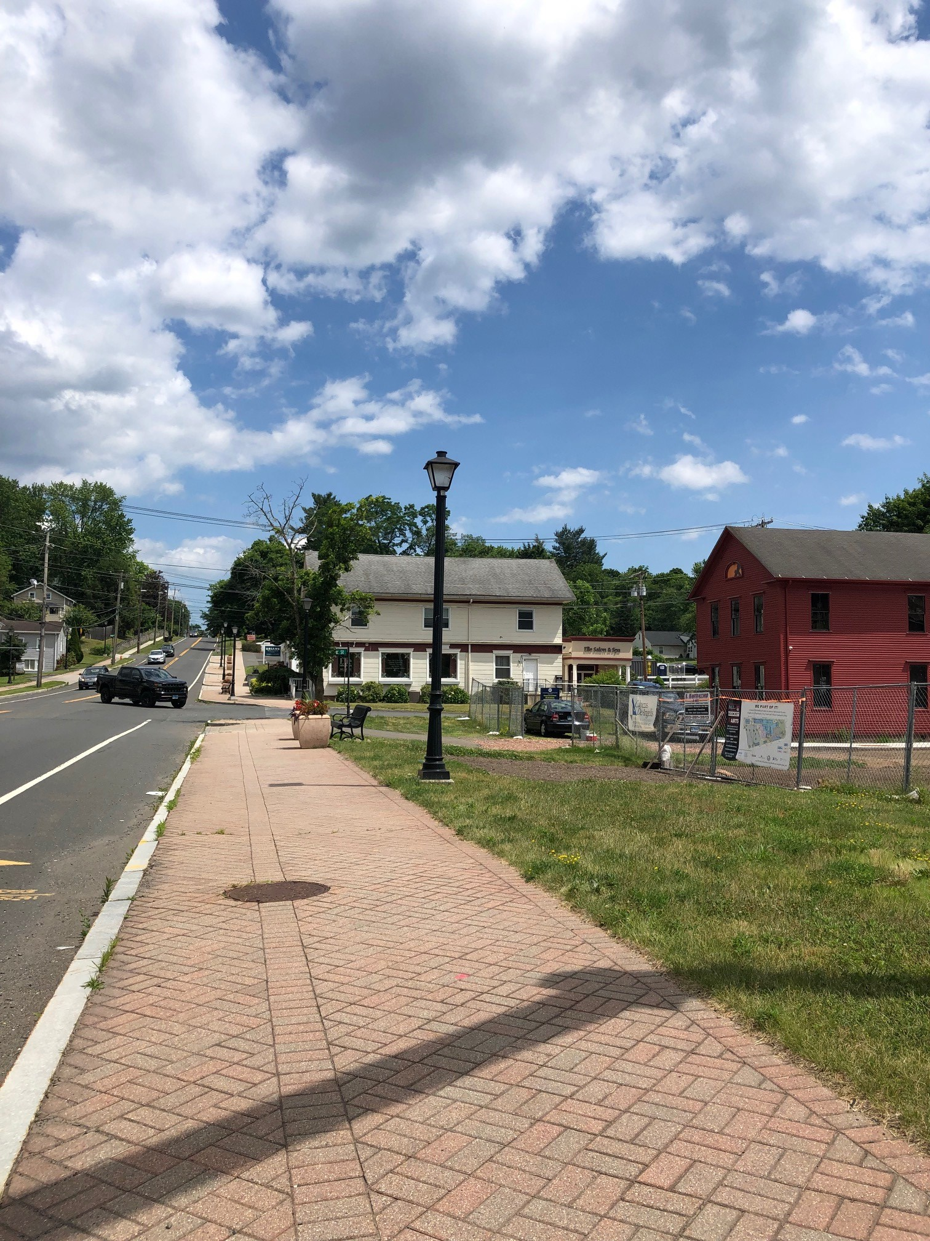
Creating a Village District in Cheshire
West Main Center

Slide 15
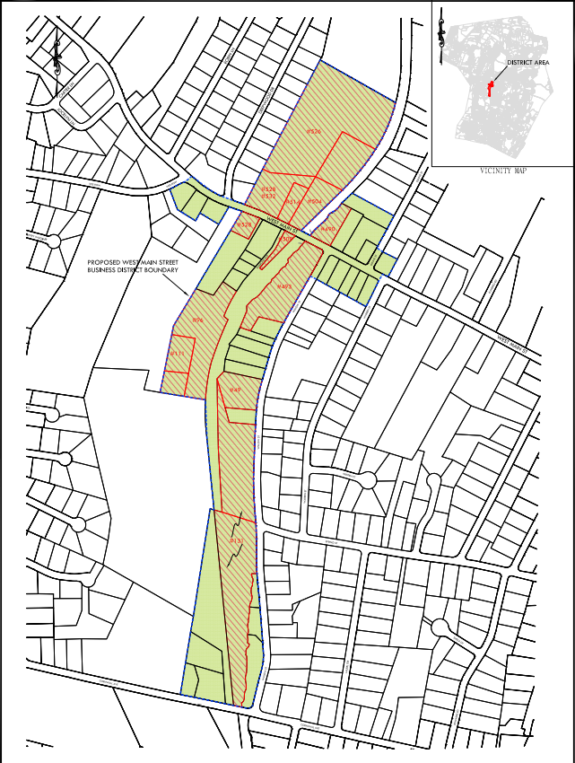

Slide 17
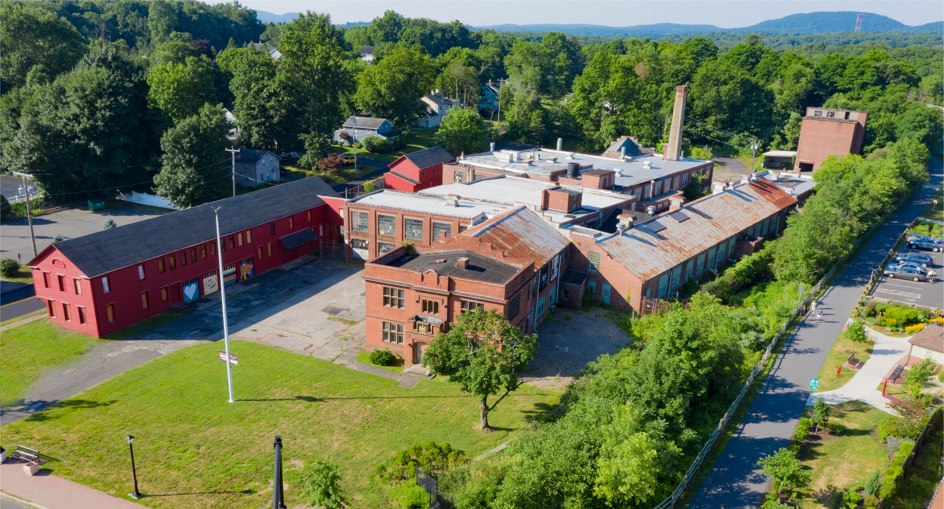

Slide 18
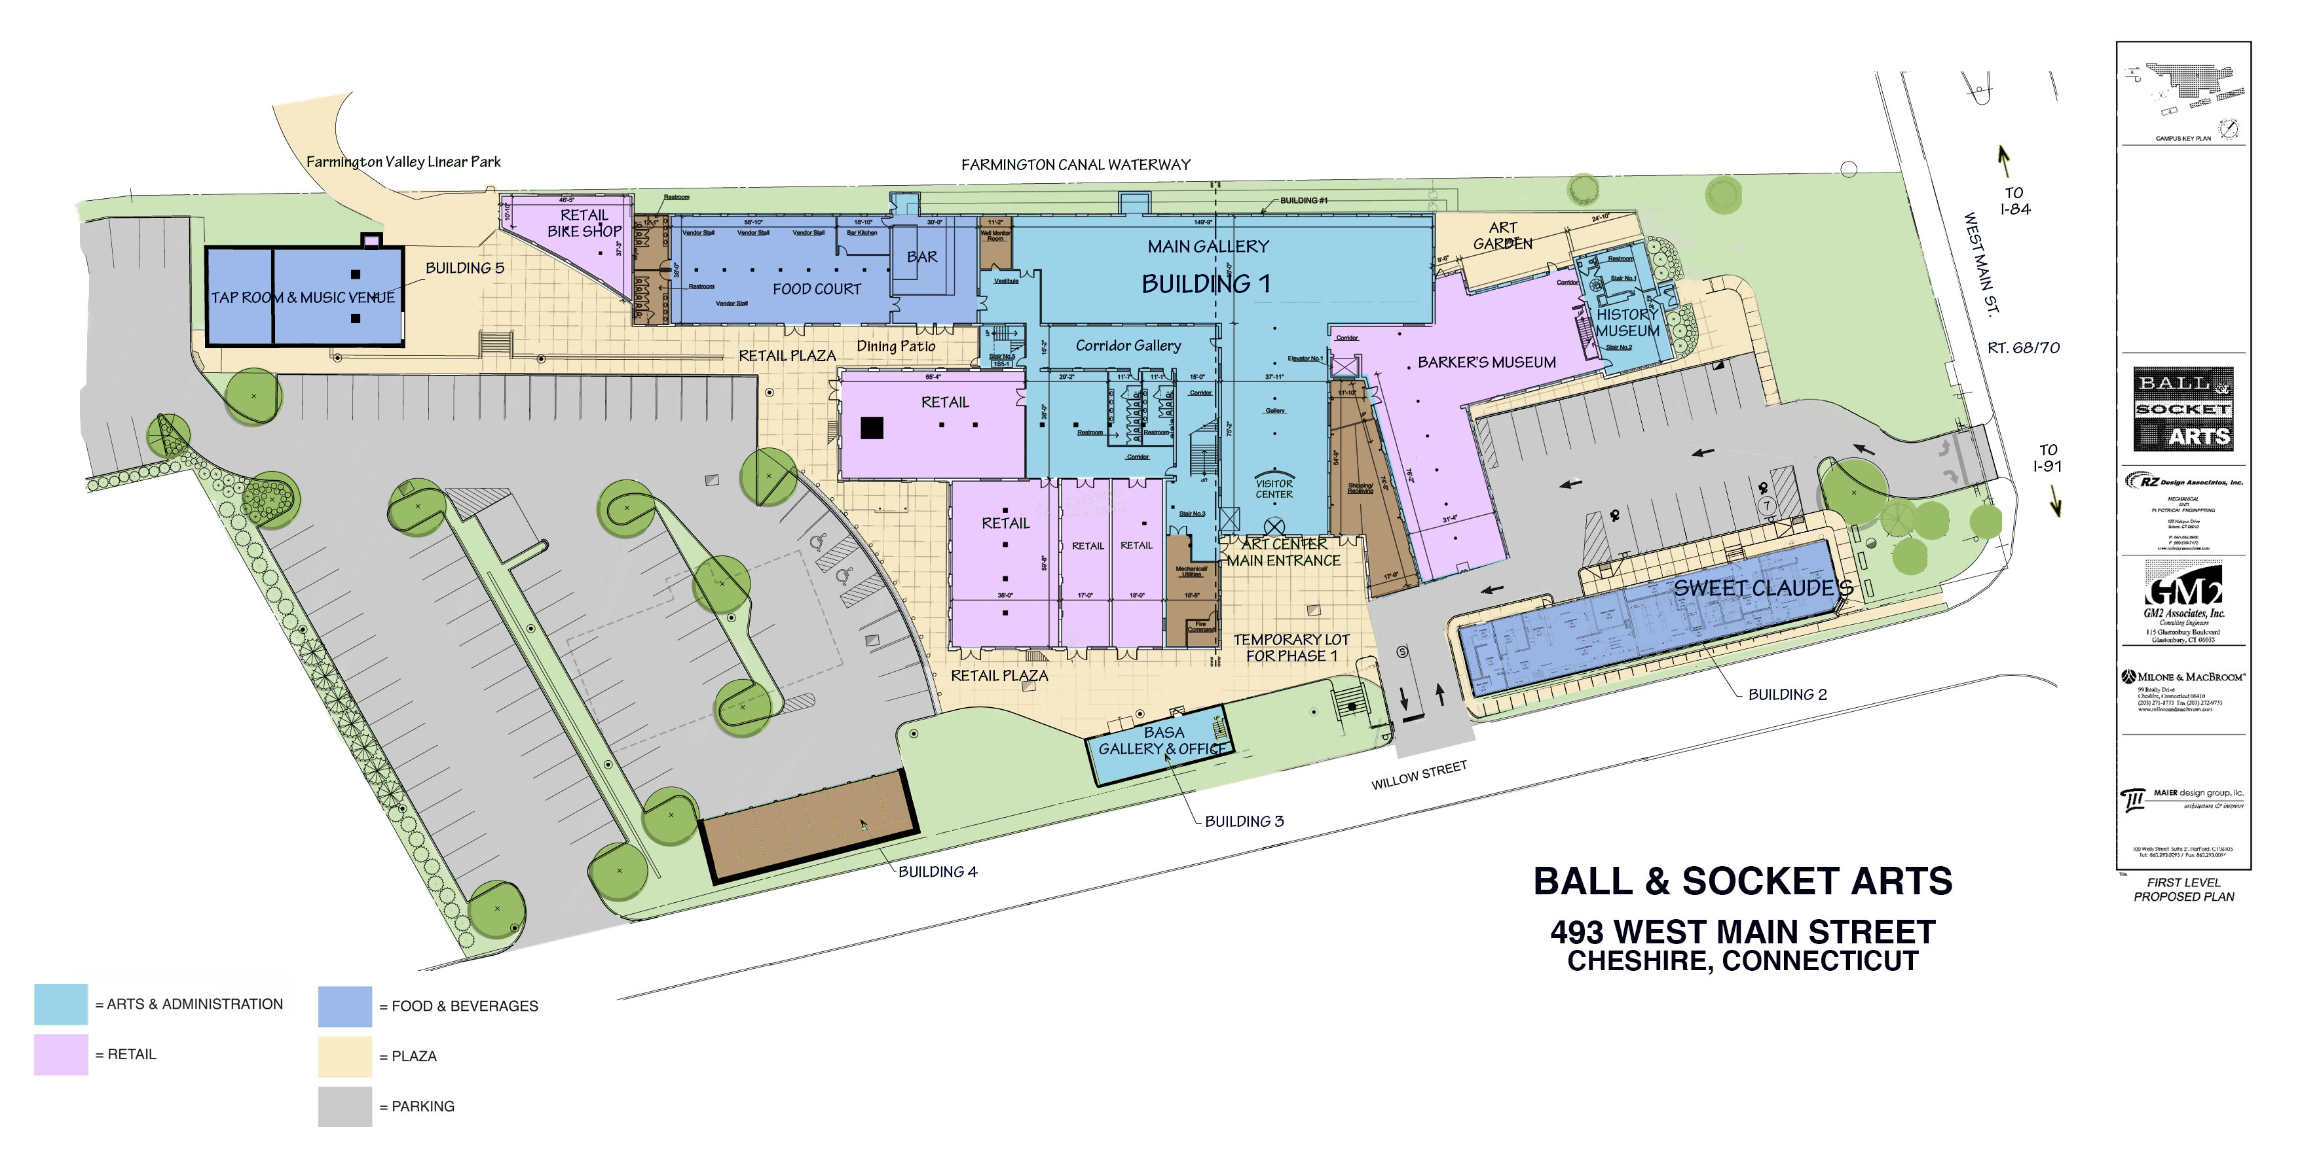
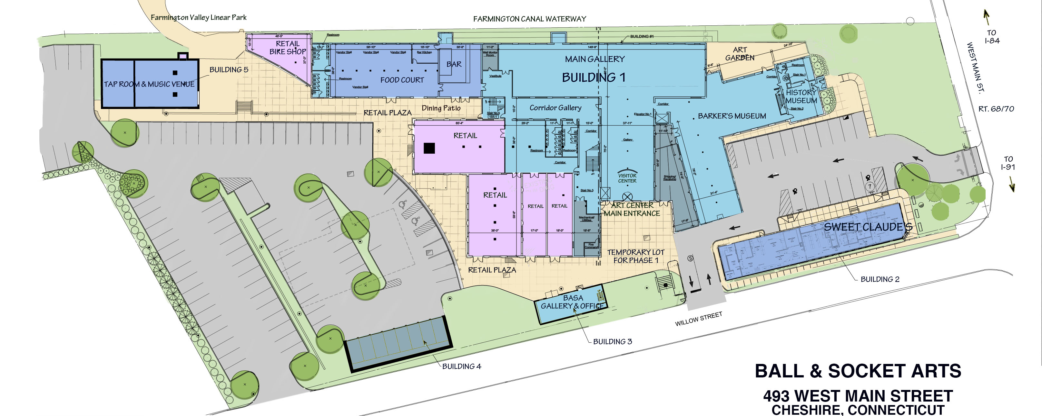
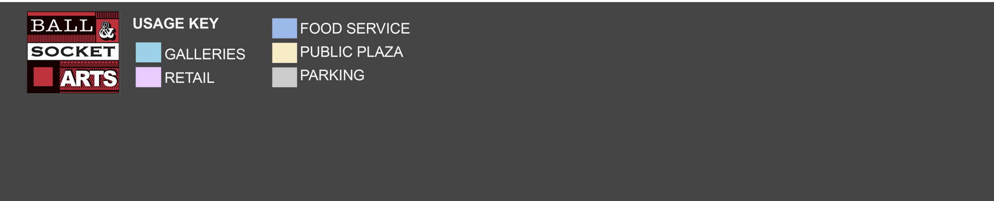
Development Plan for Ball & Socket Arts
493 West Main Street
Cheshire, Connecticut

Slide 19
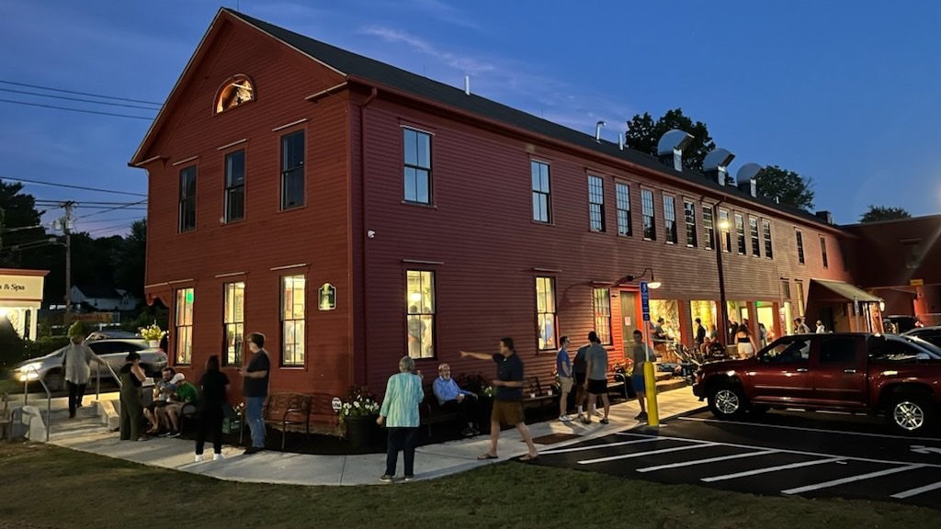

Slide 20
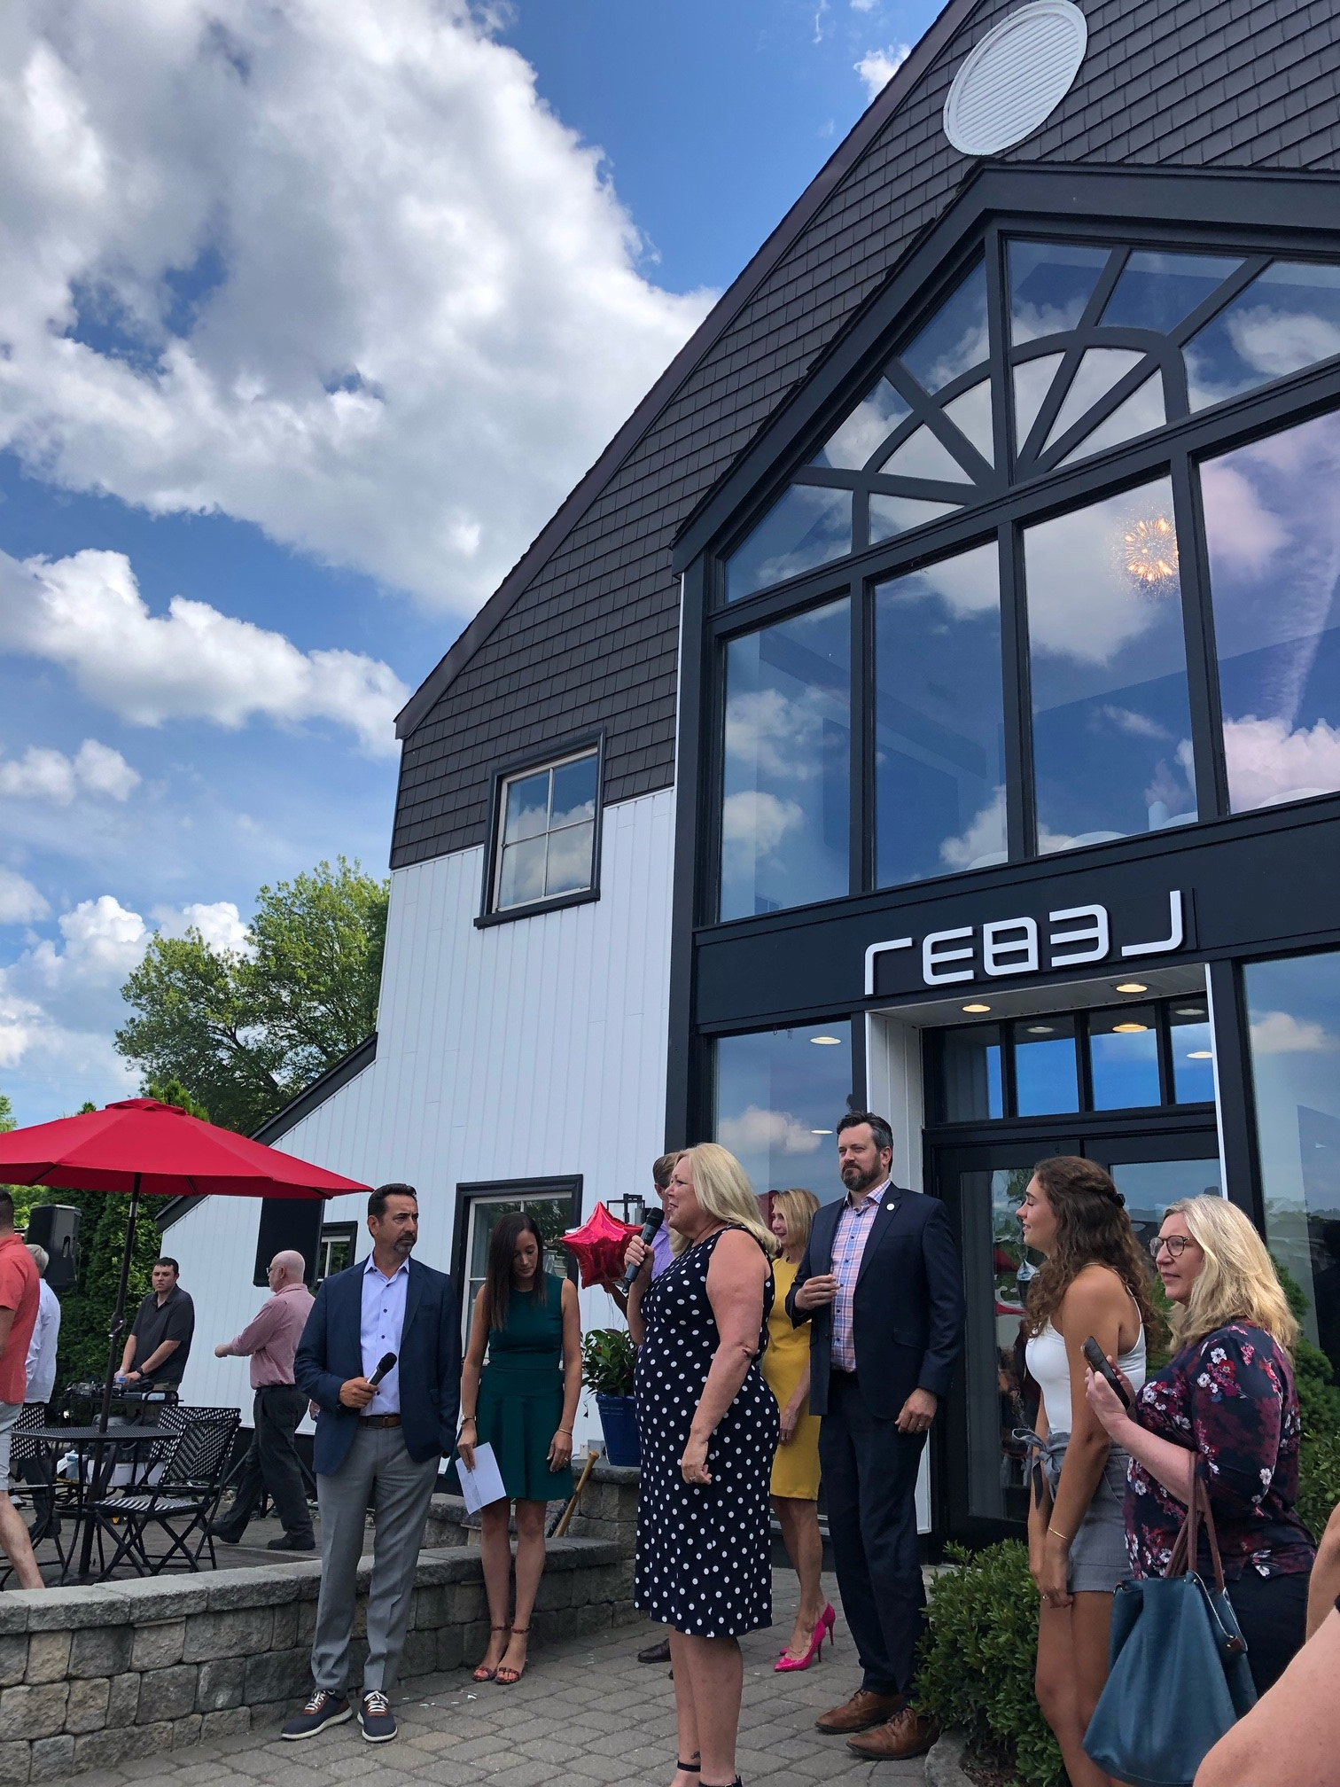
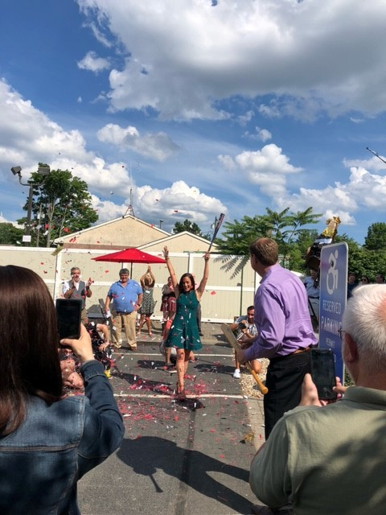

Slide 21
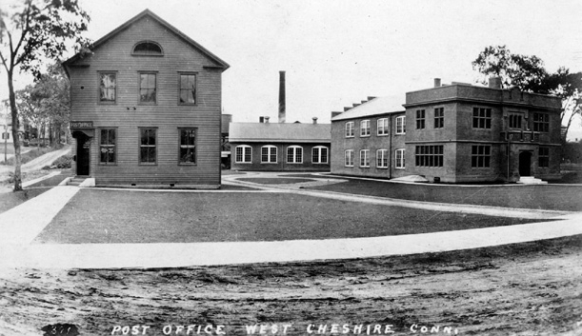
Why Form Based Code?
A form-based code (FBC) is a way to regulate development that controls building form first and building use second, with the purpose of achieving a particular type of “place "or built environment based on a community vision.

Slide 22
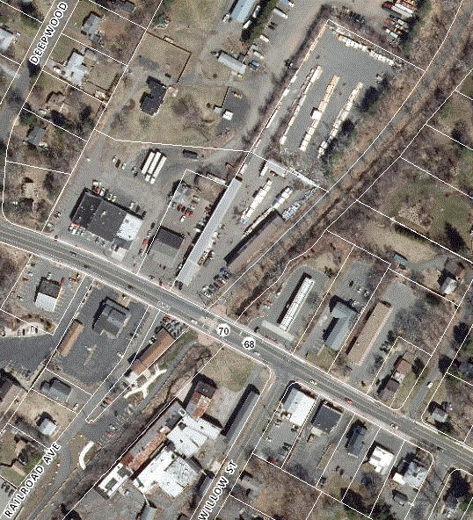
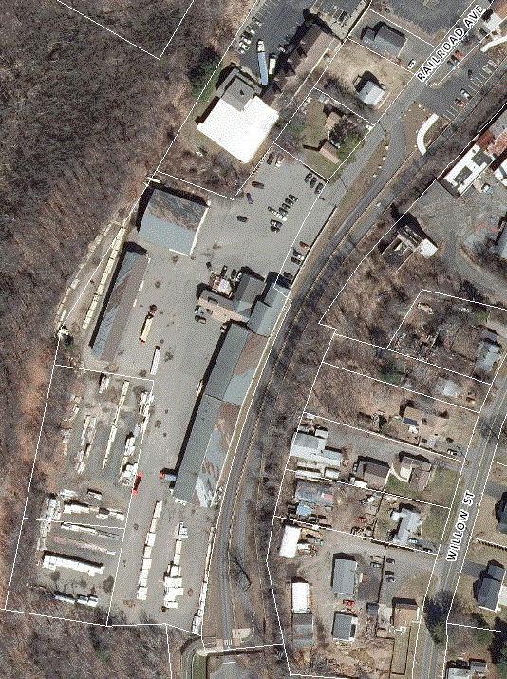
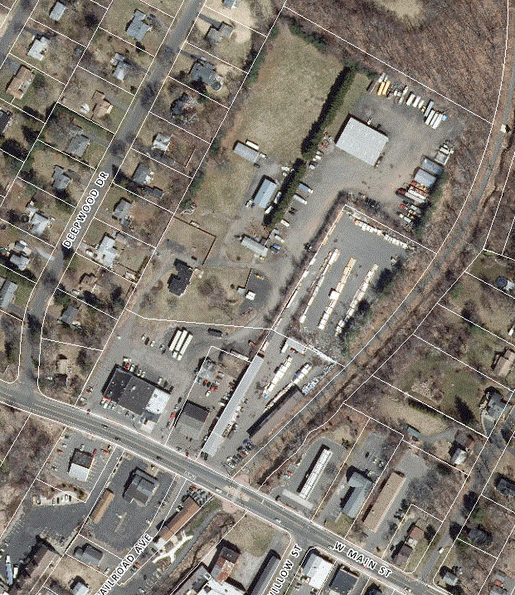
Center of Project Area. Note large lumberyard area and underutilized spaces behind commercial buildings along State Highway 70
Farmington Trail crosses center of picture with underutilized parcel immediately adjacent at center of Project Area.
Mixture of residential, commercial and industrial uses lacking a cohesive plan for future development.

Slide 23
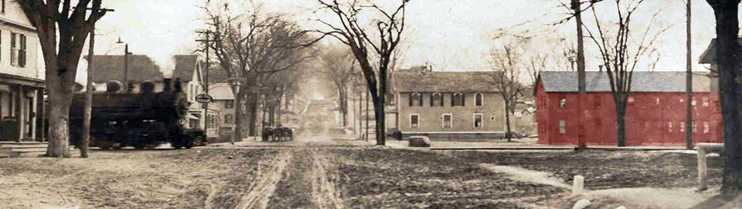
Who’s Going To Pay for Our New Code?
The Town of Cheshire applied for Brownfield Area-Wide Remediation Grant for the West Main Street District Planning Project (BAR Planning ) via DECD
  The town was awarded $90,000.00 (with a $10,000.00 community match required) for purposes of developing a flexible zoning code that will help foster redevelopment and reinvestment within the West Main Street District.
  The community envisions using a form-based code to promote flexible regulations that place an emphasis on placemaking while improving pedestrian experience.

Slide 24
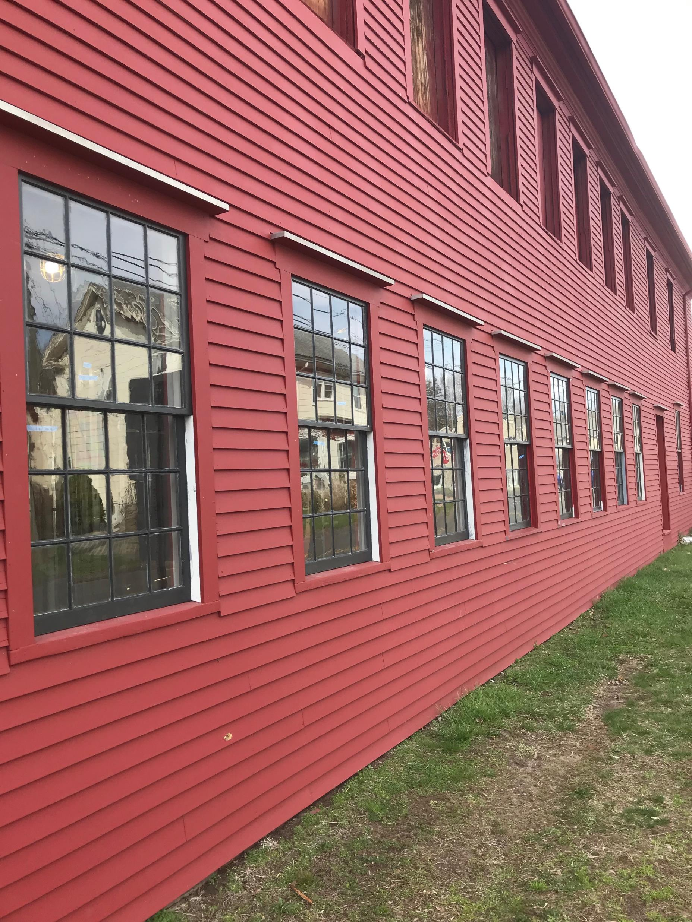
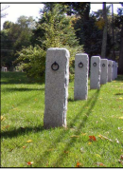
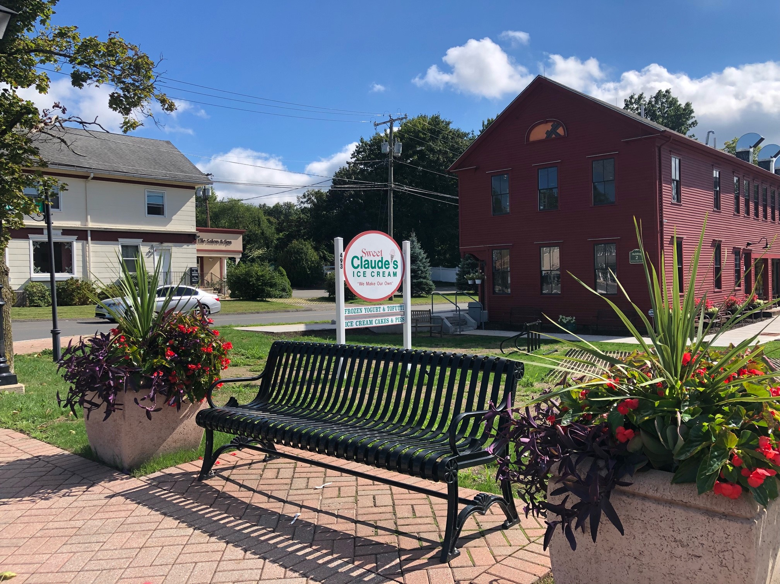
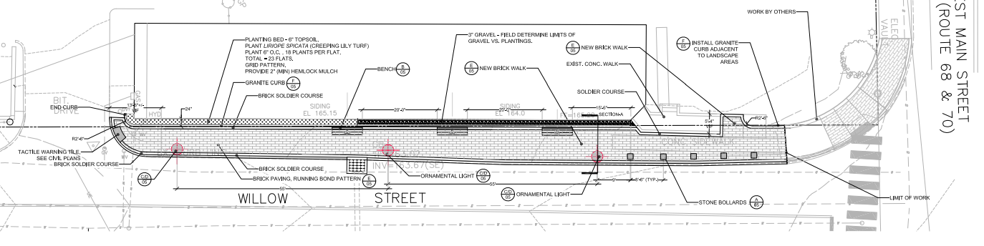

Slide 25
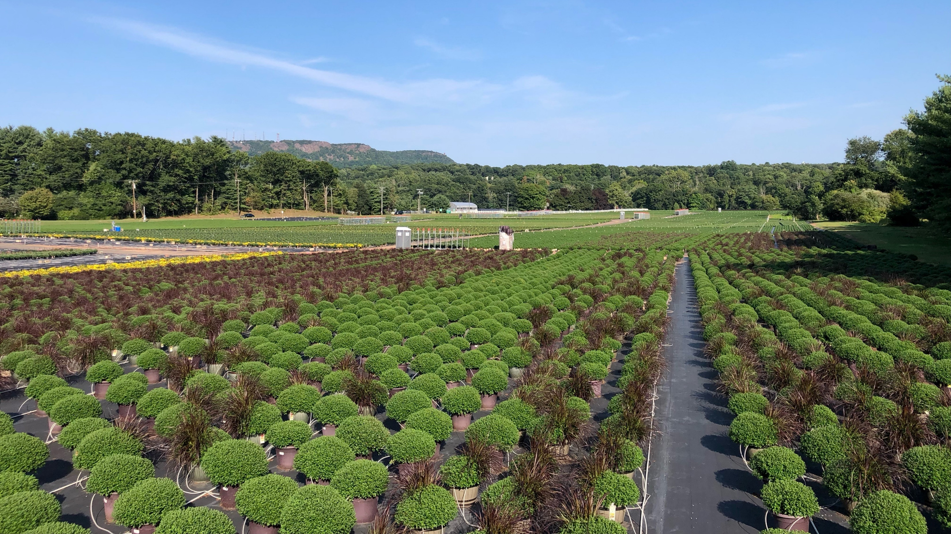
Questions?
Thank – you!

